Slide 1
Appendix 5: Results of Regional Kendall Test (RKT) for years 1992 through 2012, for HUC-4 areas (n = 202 in CONUS)
For variables with data for at least 4 time periods between 1992-2012
HUC = Hydrologic Unit Code. VPU = Vector Processing Unit (NHDPlus HUC-02 regions).
HUC-04 boundaries from National Resources Conservation Service, (https://nrcs.app.box.com/v/huc/folder/39640323180) (NRCS, 2018).
VPU boundaries from NHDPlus ,(http://www.horizon-systems.com/nhdplus/) (McKay et al., 2012).
State boundaries from 2010 U.S. Census cartographic boundaries (https://www.census.gov/geo/maps-data/data/cbf/cbf_state.html).
Coordinate system: Albers Equal-Area Conic Projection NAD83
Projection: Albers
Datum: North American 1983
False Easting: 0
False Northing: 0
Central Meridian: -96.0000
Standard Parallel 1: 29.5000
Standard Parallel 2: 45.5000
Latitude of Origin: 23.0000
Units: Meter

Slide 2
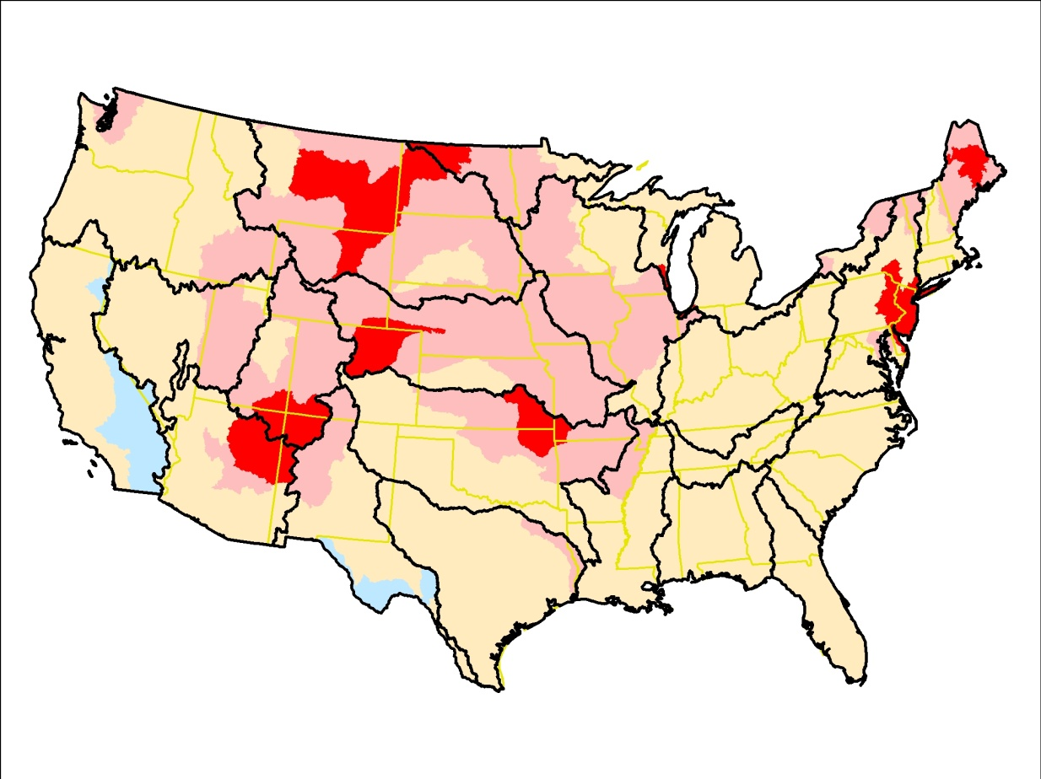
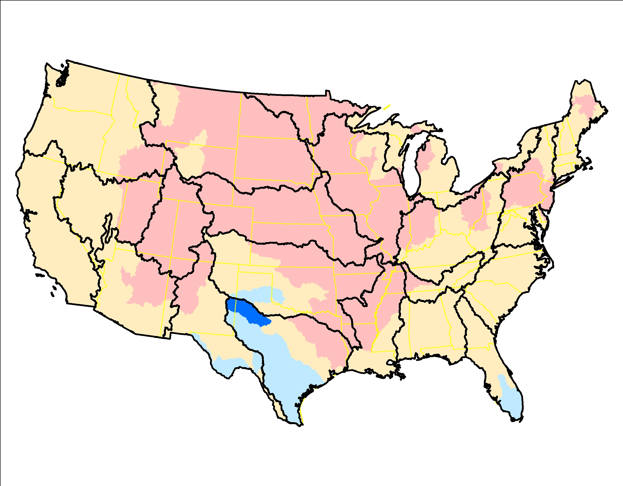
Atmospheric deposition of calcium (Ca), 1992-2012, RKT trend significance (left) and slope of trend (right)

Slide 3
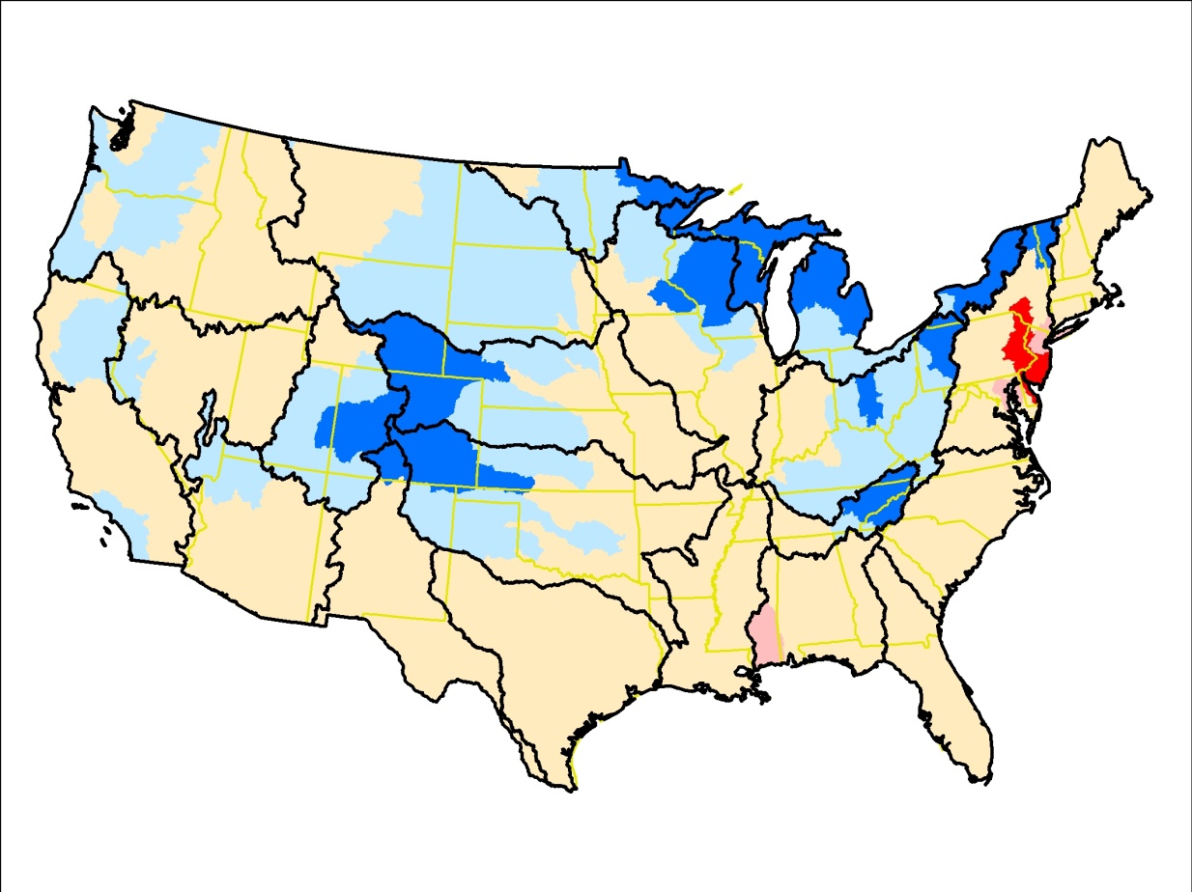
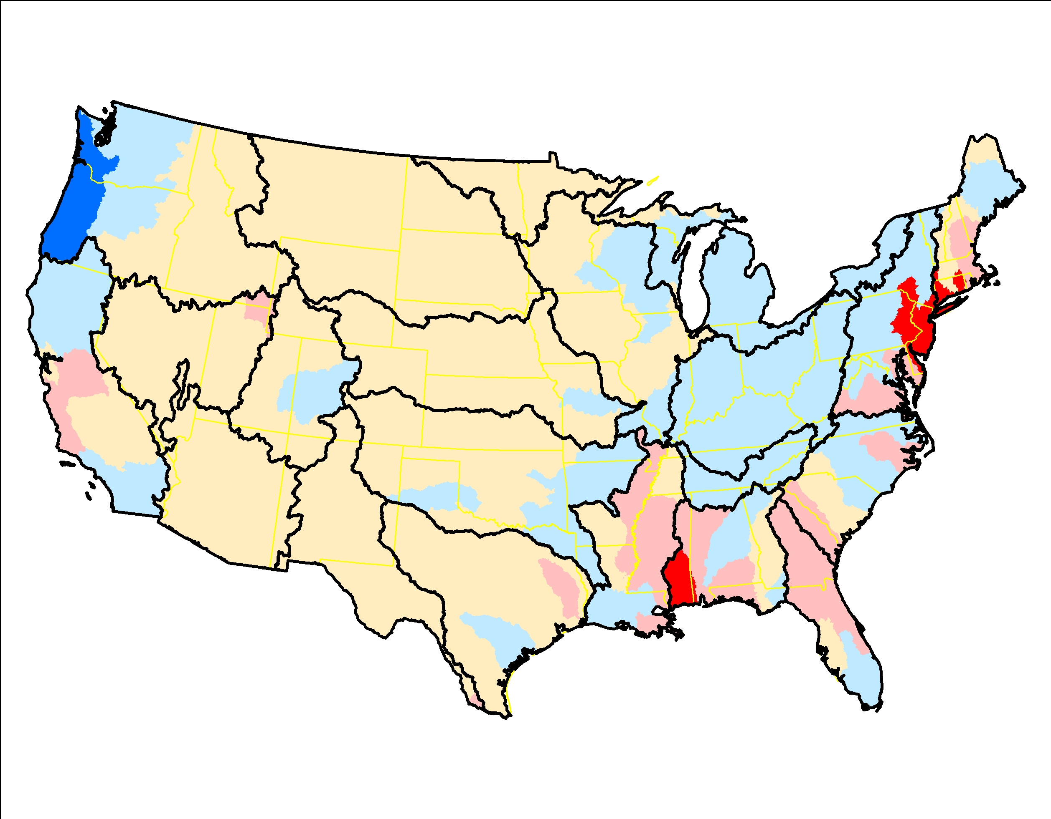
Atmospheric deposition of chloride (Cl), 1992-2012, RKT trend significance (left) and slope of trend (right)

Slide 4
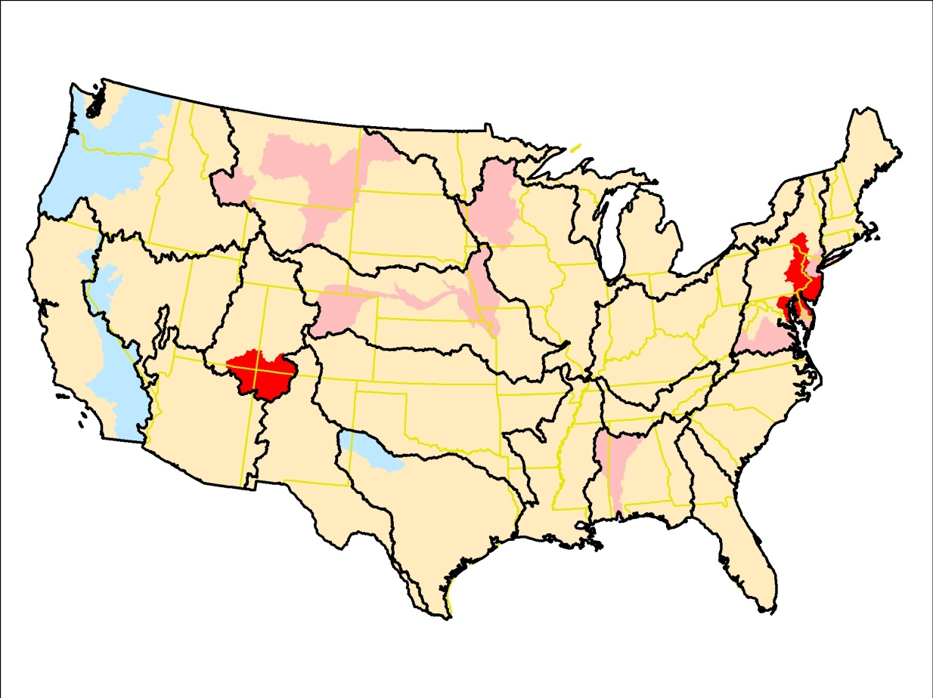
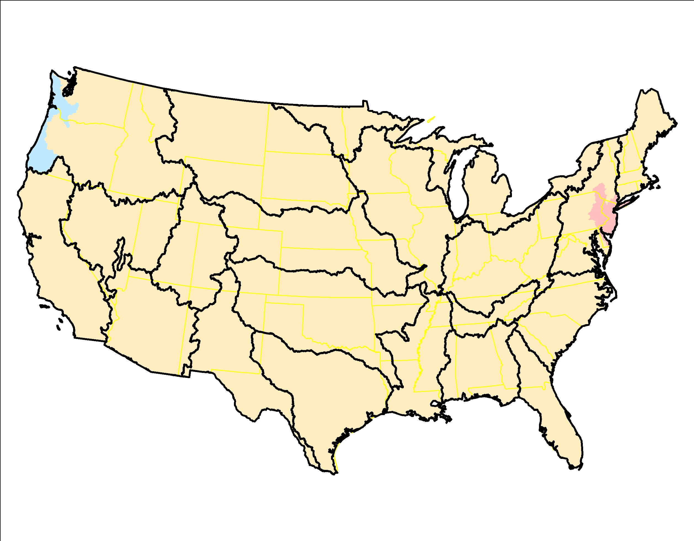
Atmospheric deposition of magnesium (Mg), 1992-2012, RKT trend significance (left) and slope of trend (right)

Slide 5
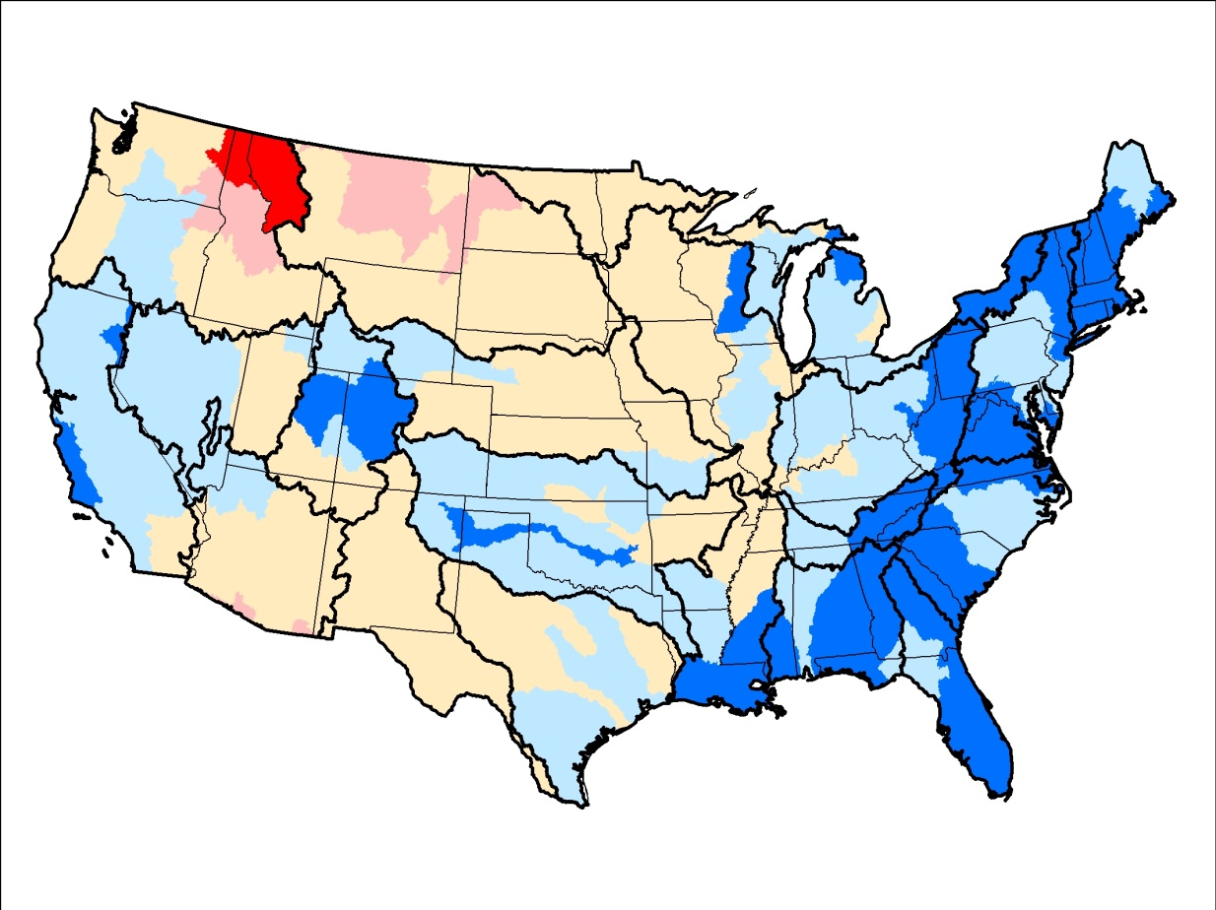
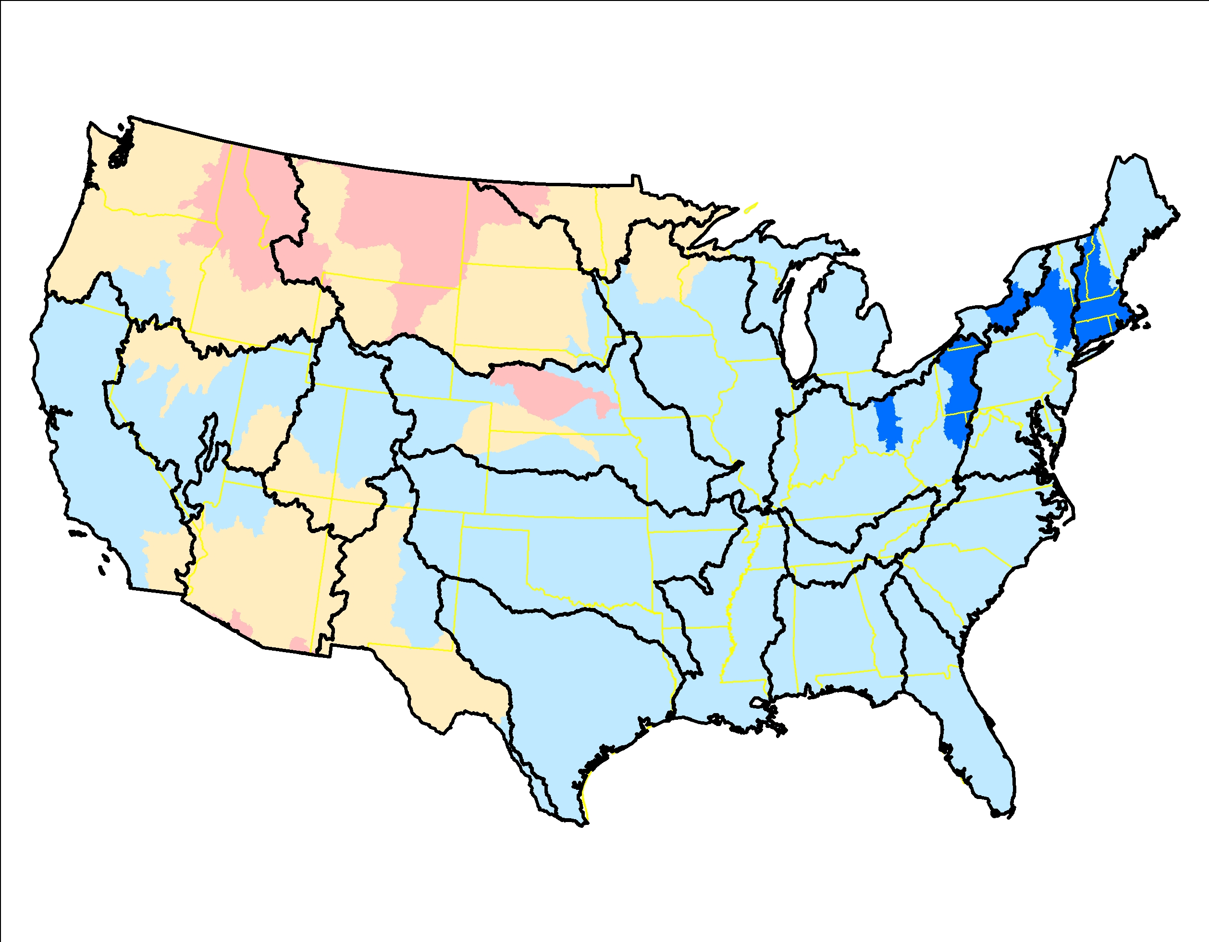
Atmospheric deposition of nitrogen (N), 1992-2012, RKT trend significance (left) and slope of trend (right)

Slide 6
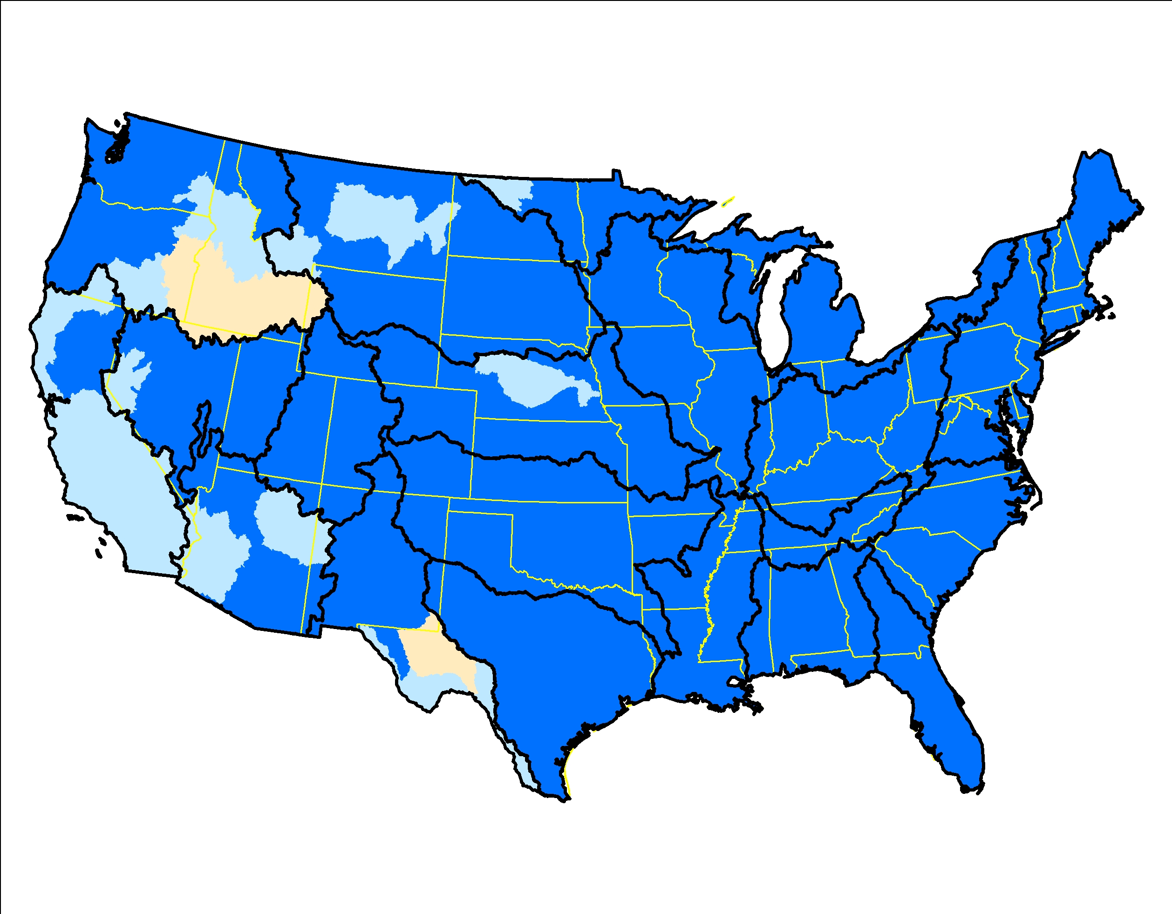
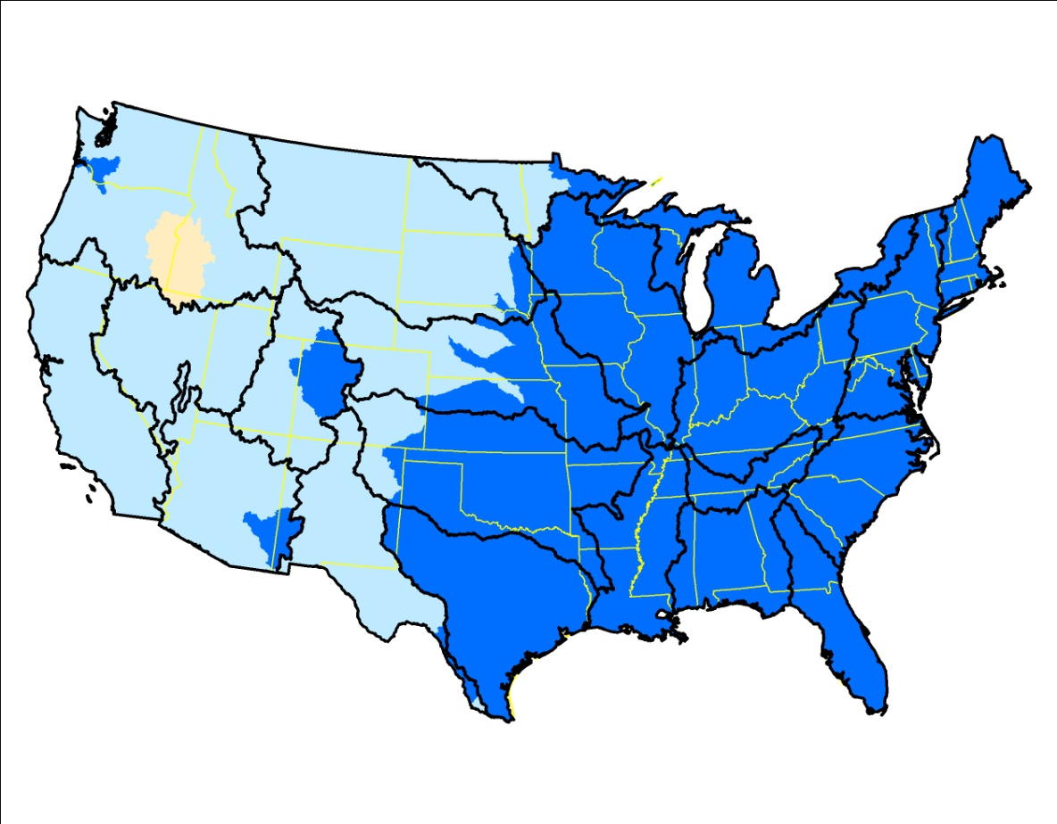
Atmospheric deposition of sulfate (SO4), 1992-2012, RKT trend significance (left) and slope of trend (right)

Slide 7
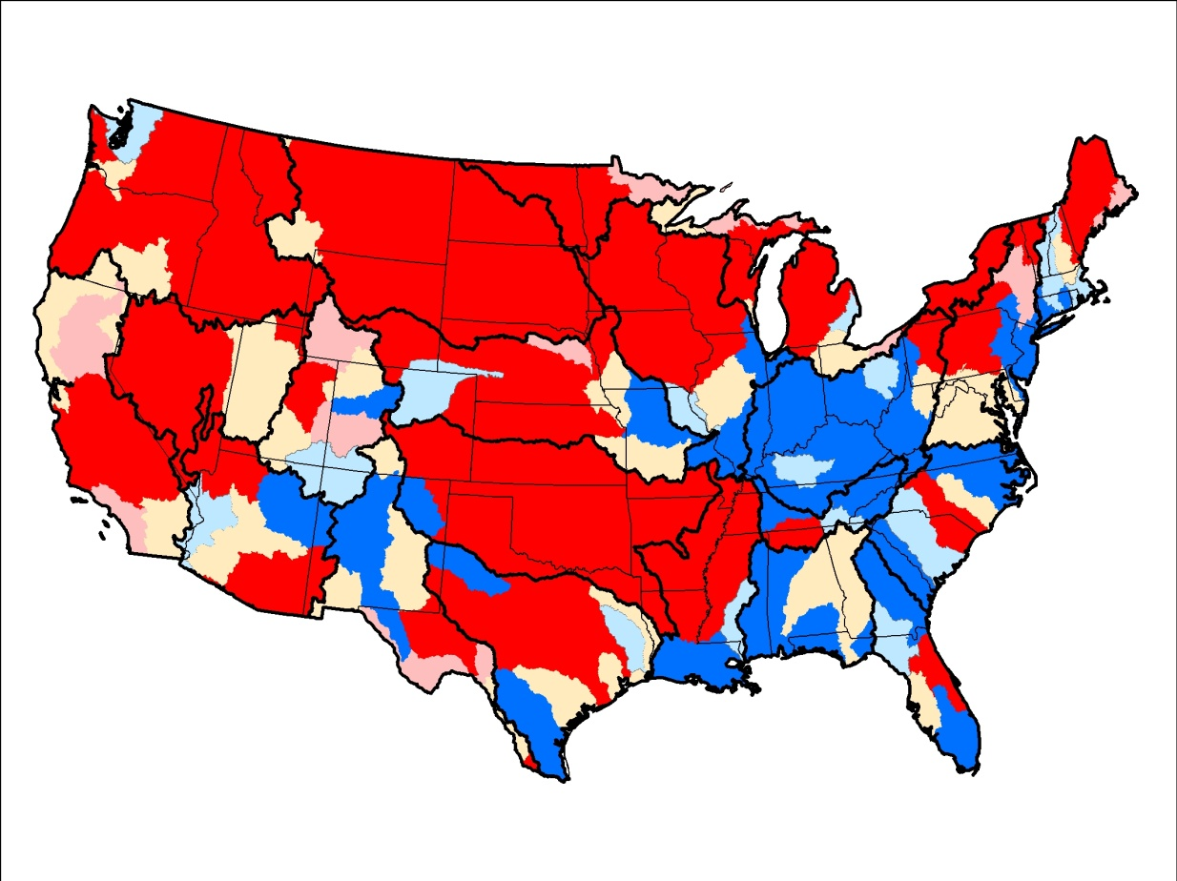
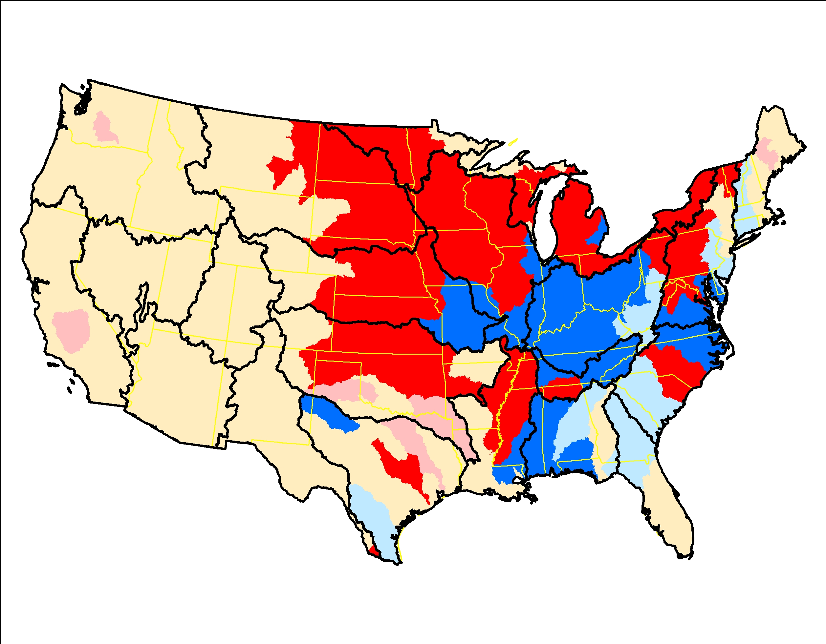
Corn for grain, 1992-2012, RKT trend significance (left) and slope of trend (right)

Slide 8
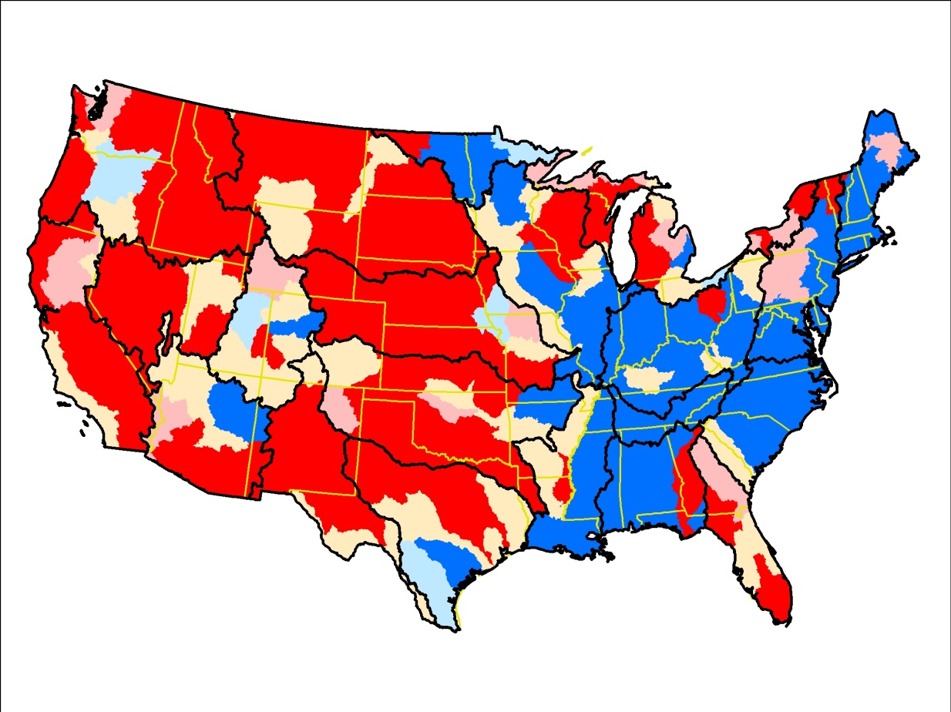
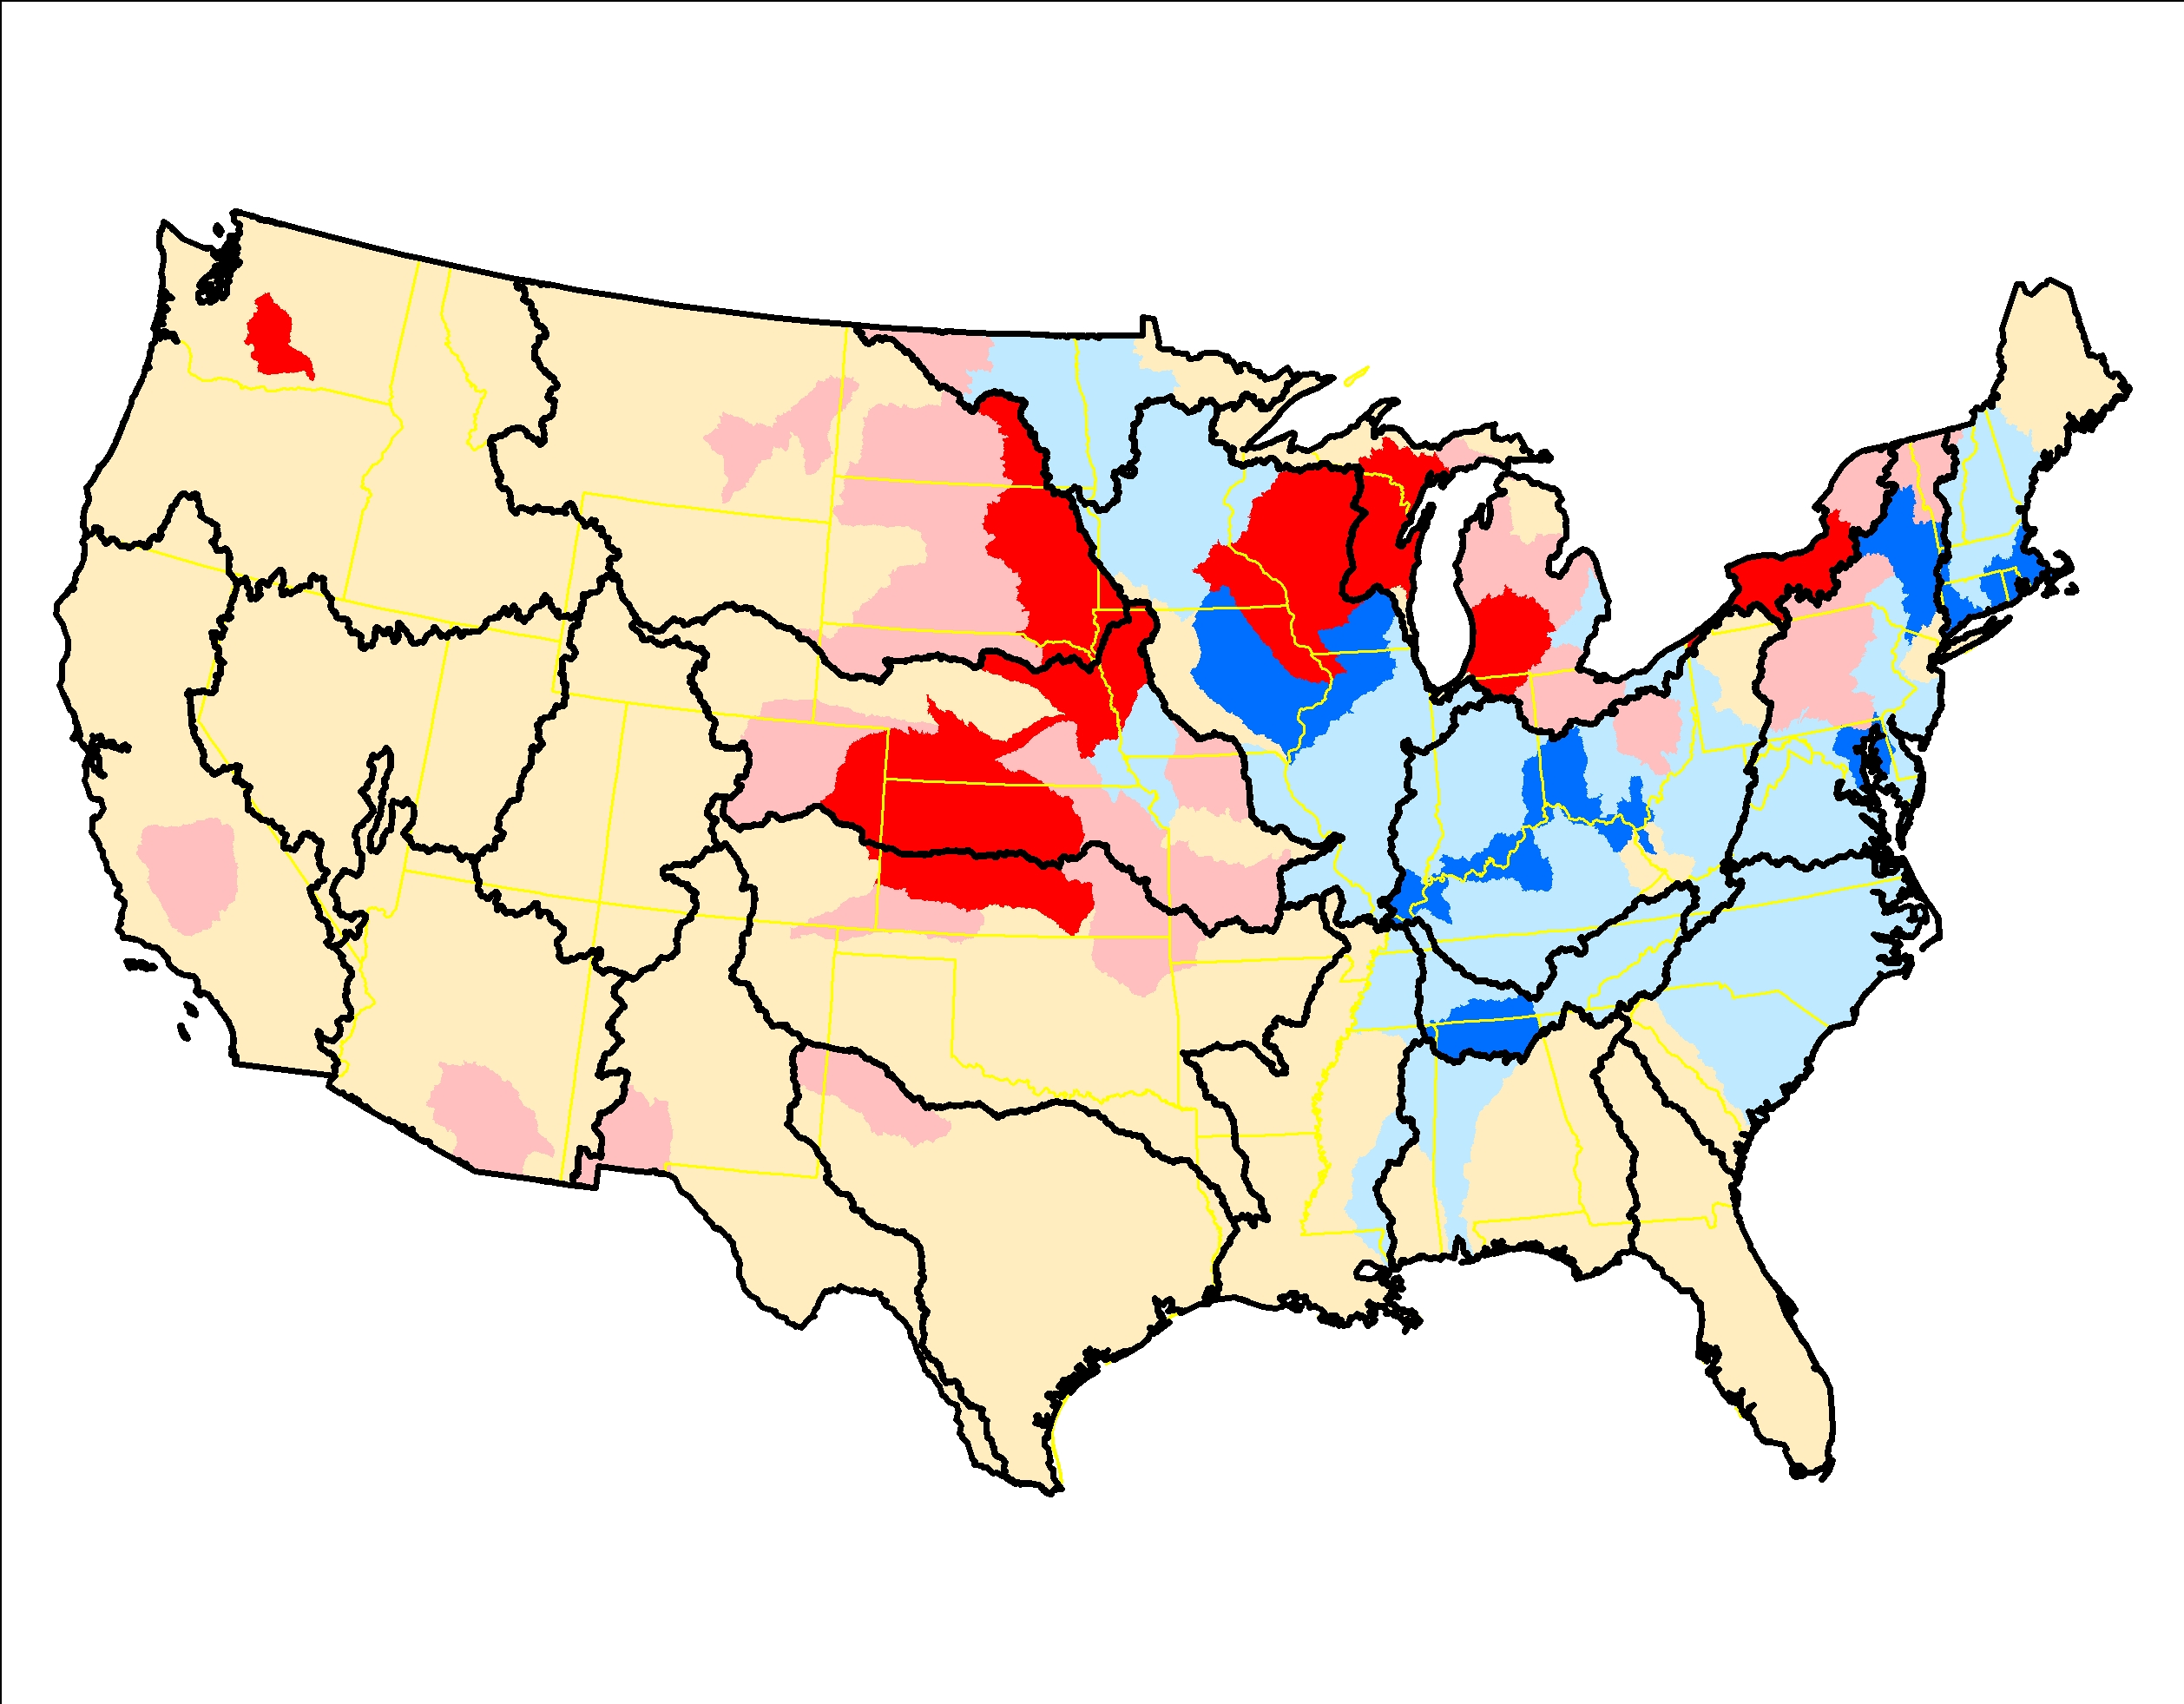
Corn for silage, 1992-2012, RKT trend significance (left) and slope of trend (right)

Slide 9
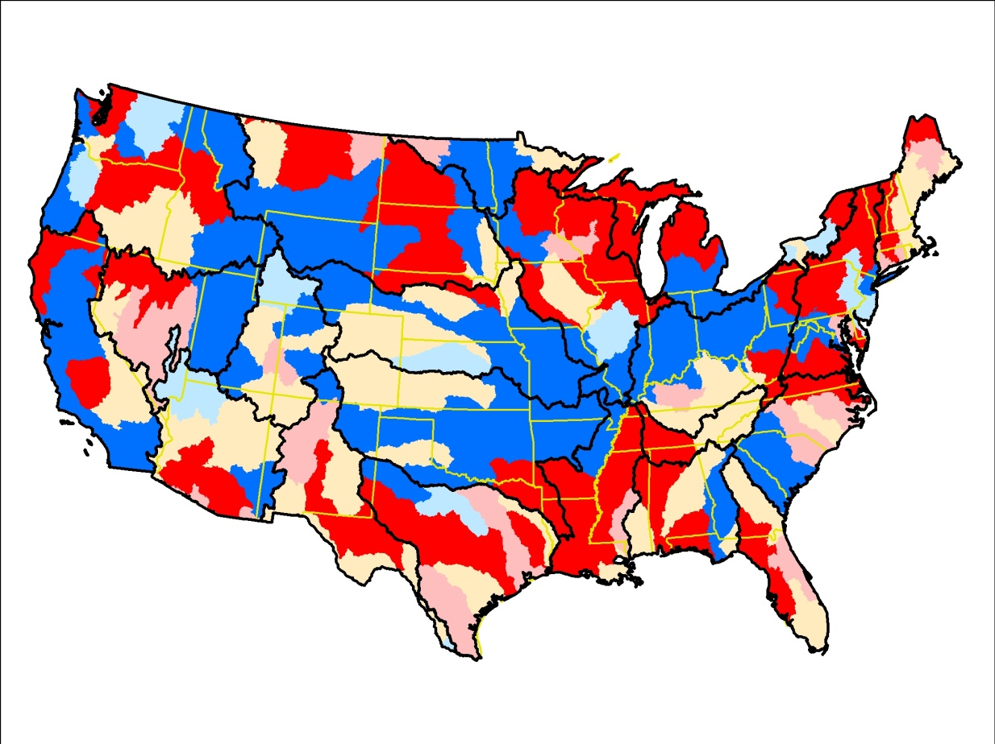
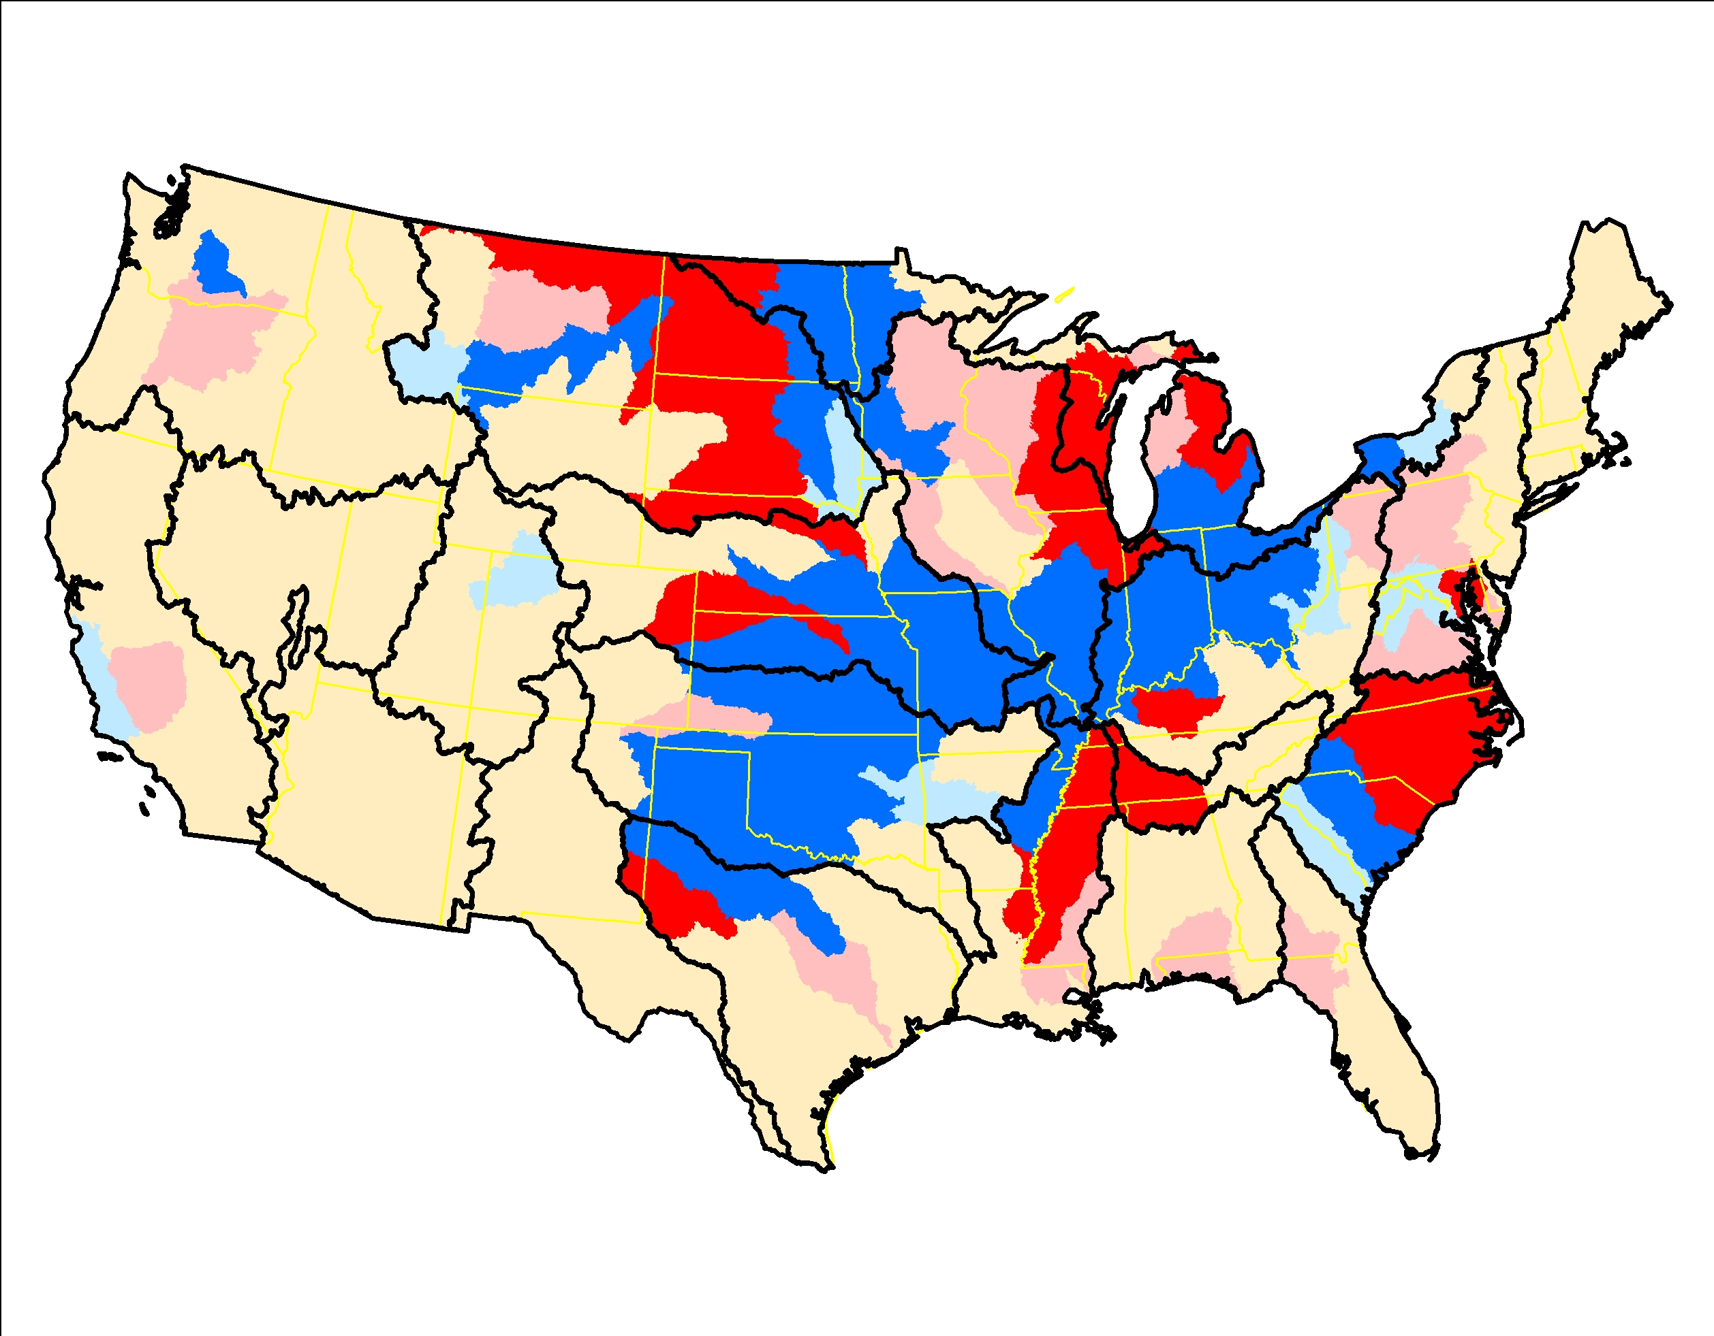
Wheat, 1992-2012, RKT trend significance (left) and slope of trend (right)

Slide 10
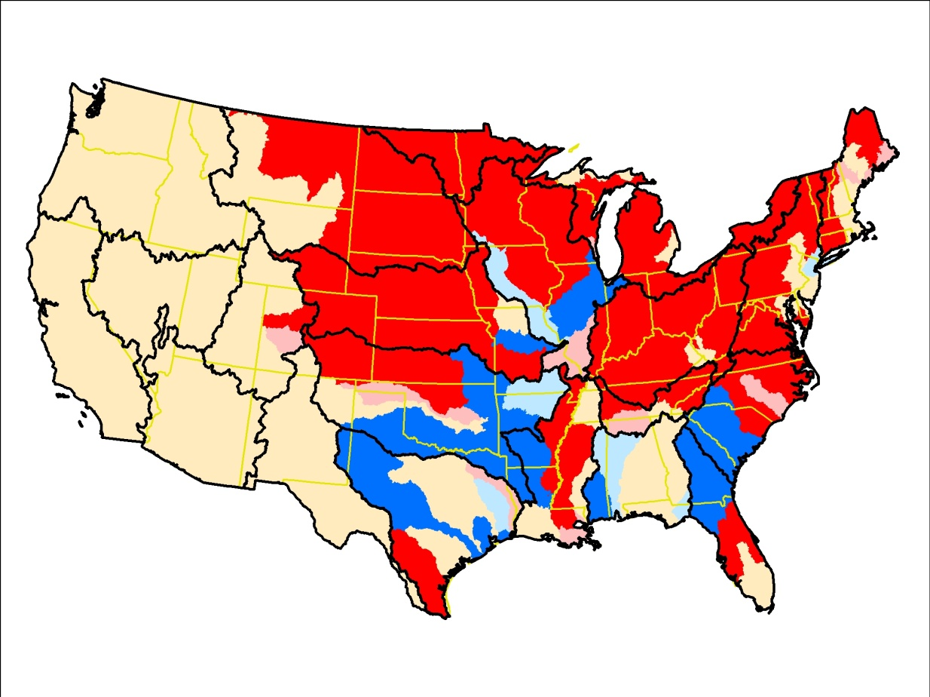
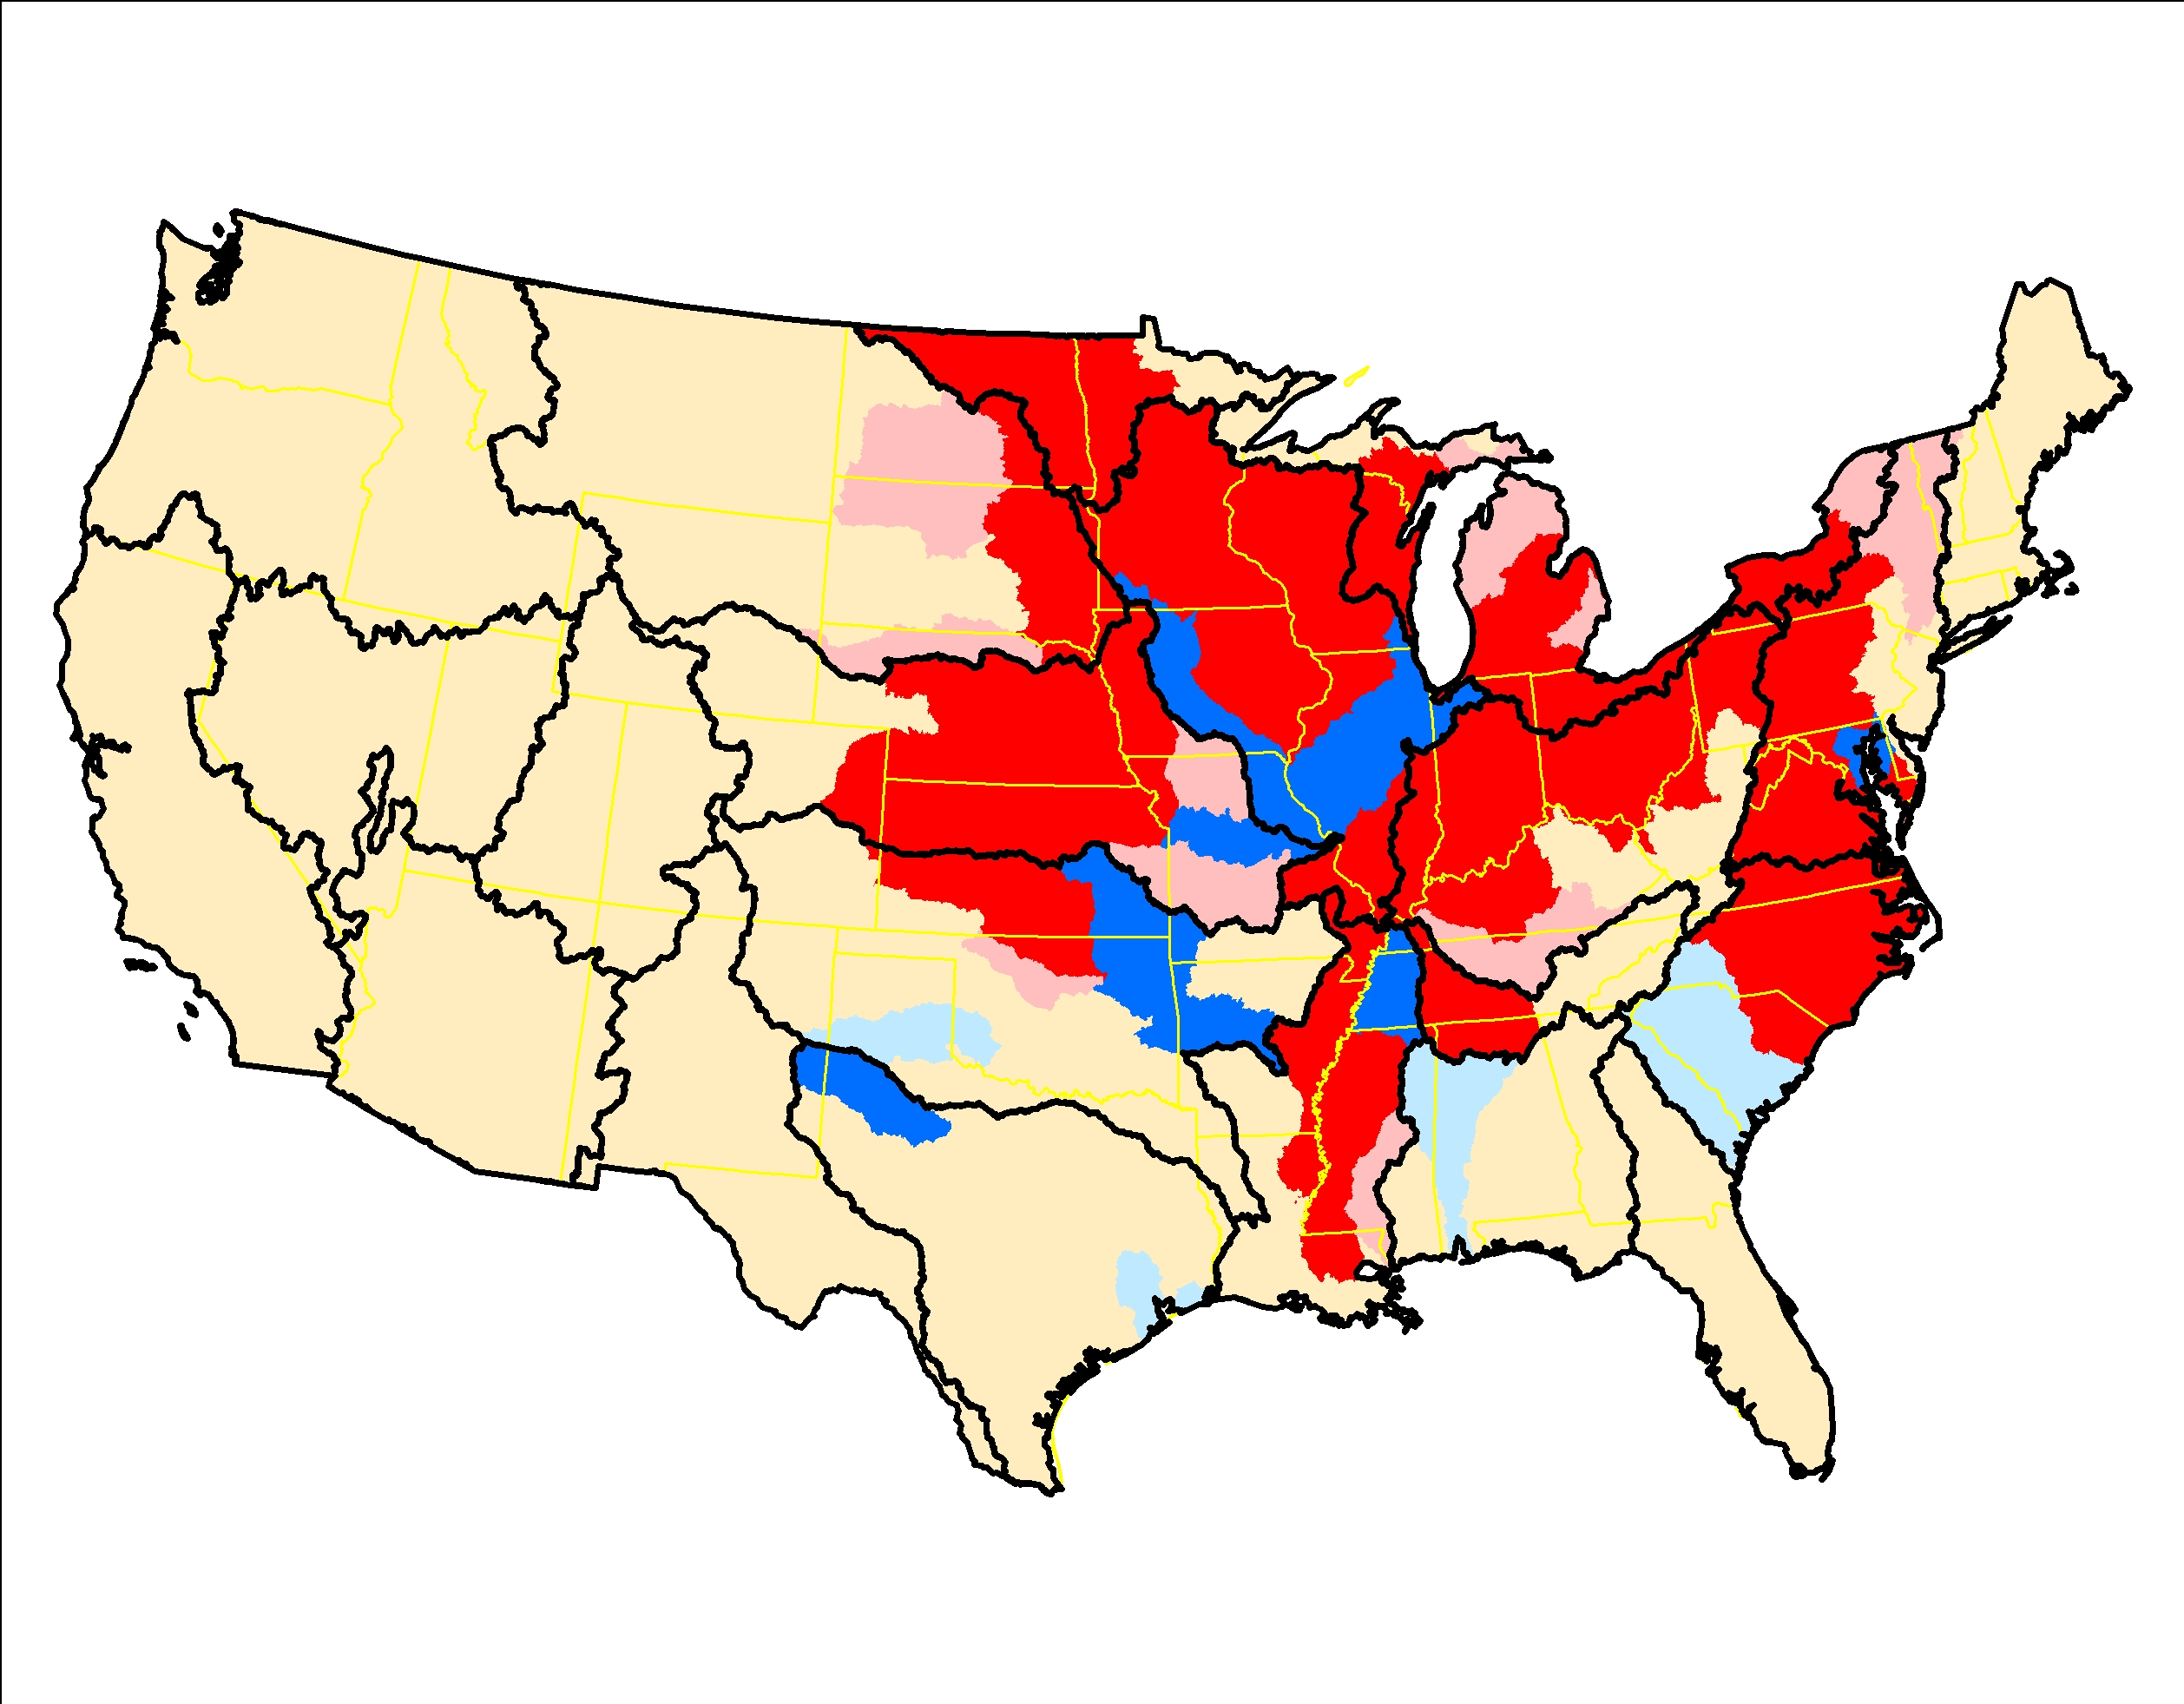
Soybeans, 1992-2012, RKT trend significance (left) and slope of trend (right)

Slide 11
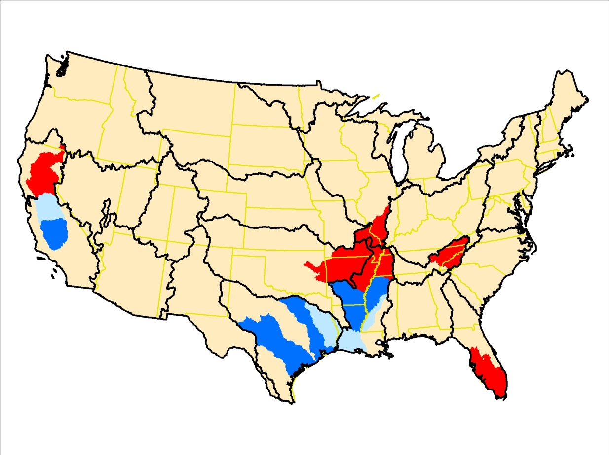
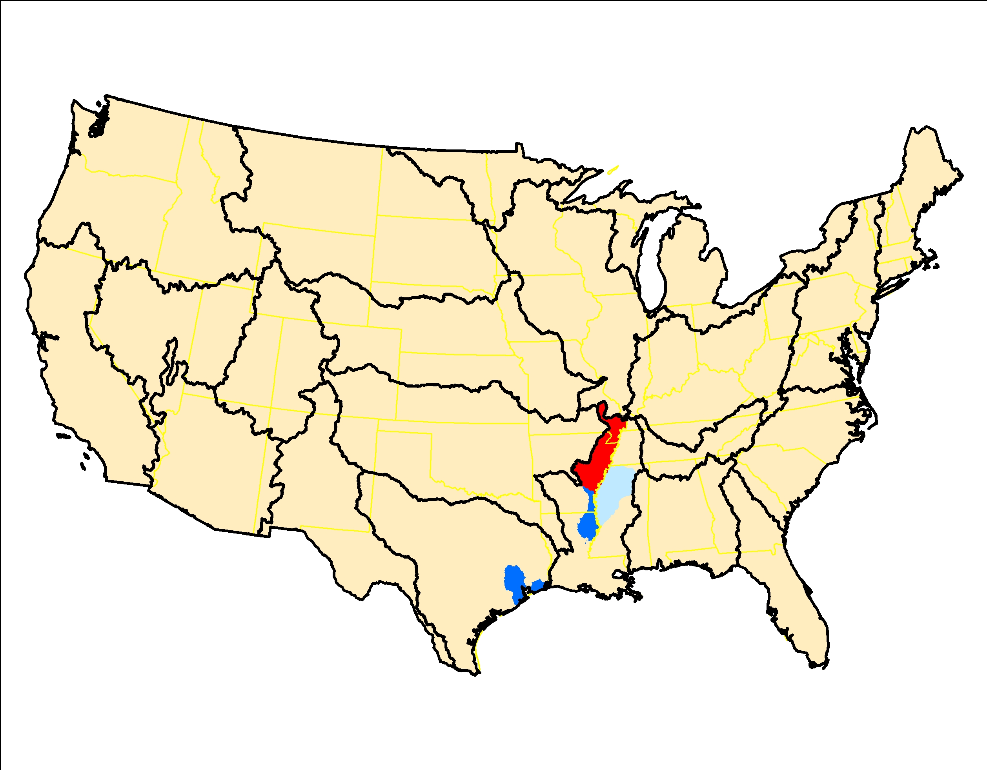
Rice, 1992-2012, RKT trend significance (left) and slope of trend (right)

Slide 12
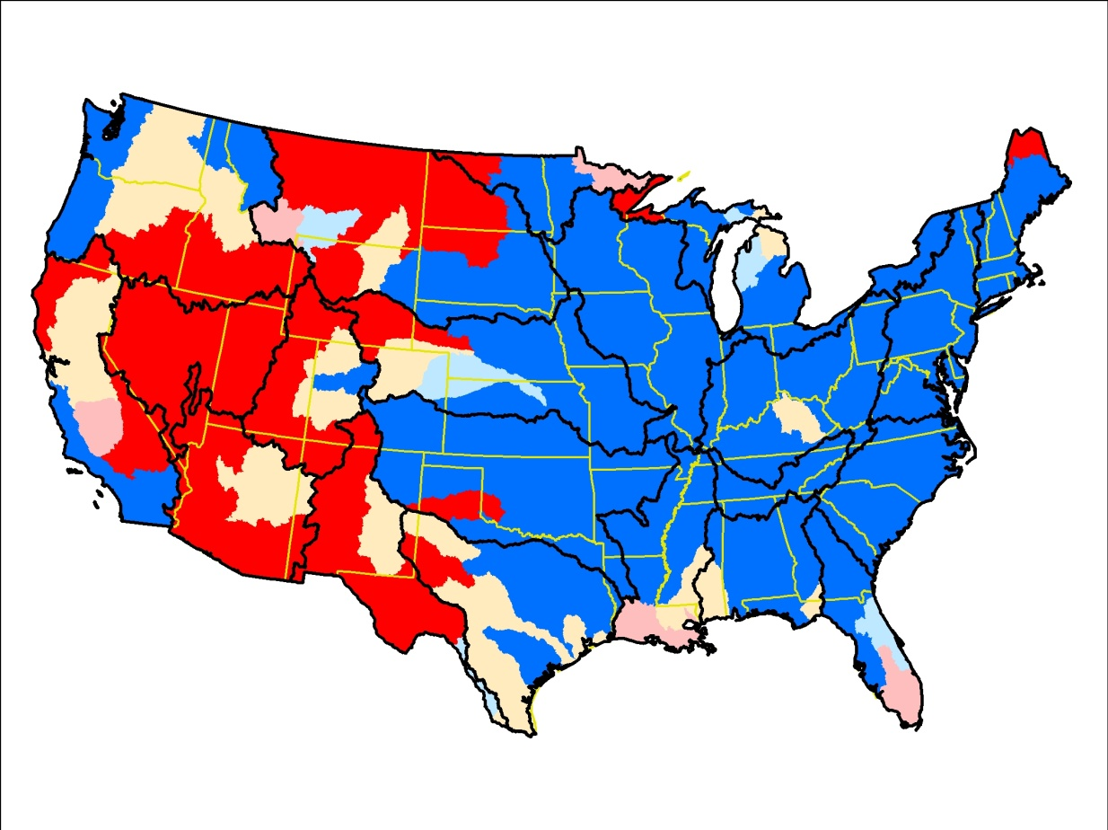
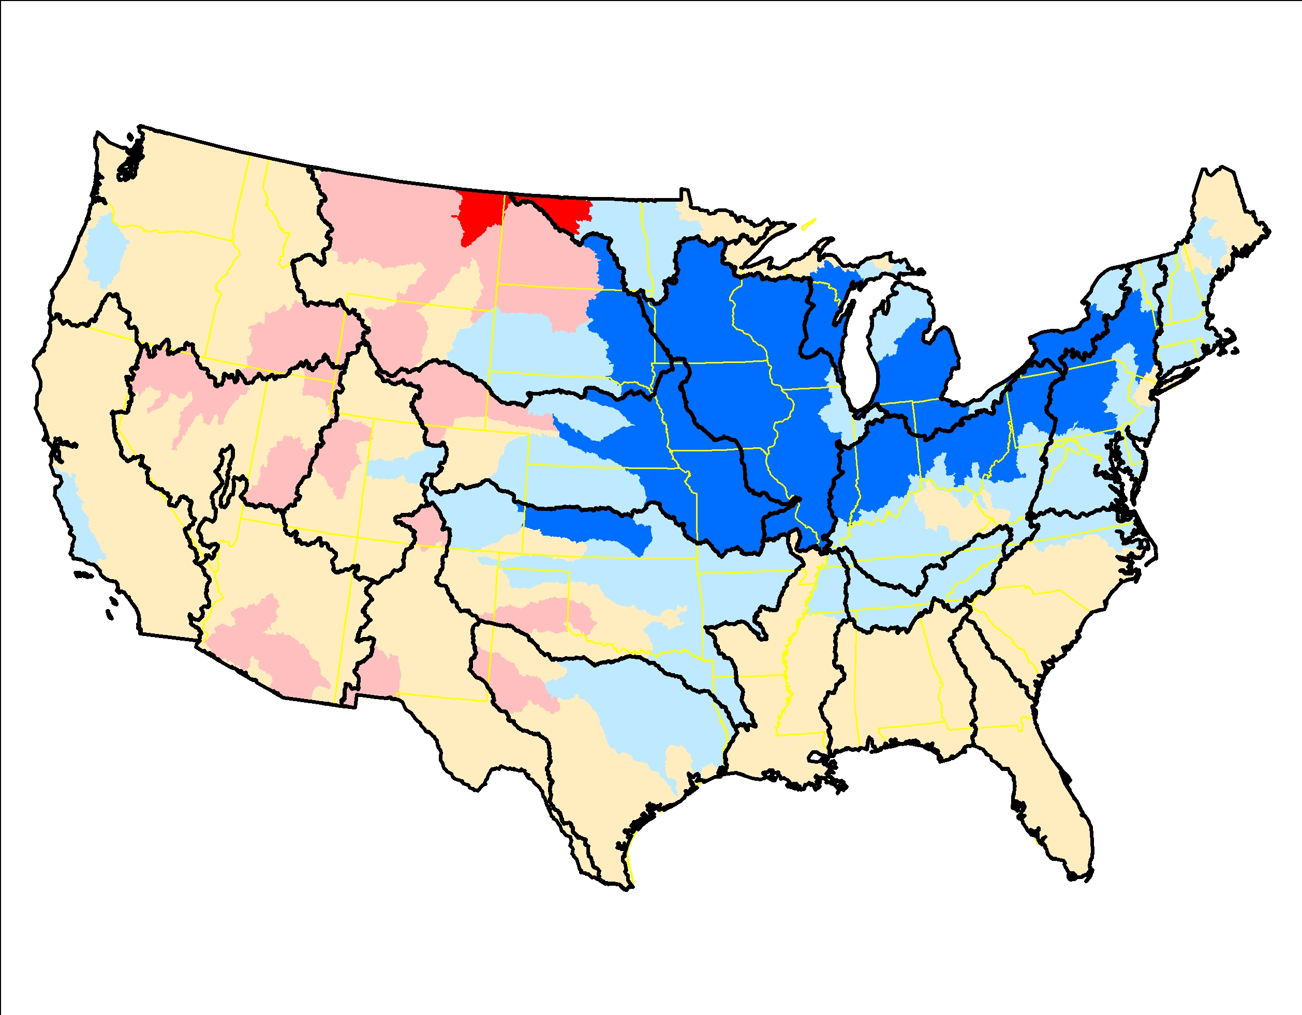
Hay-alfalfa, 1992-2012, RKT trend significance (left) and slope of trend (right)

Slide 13
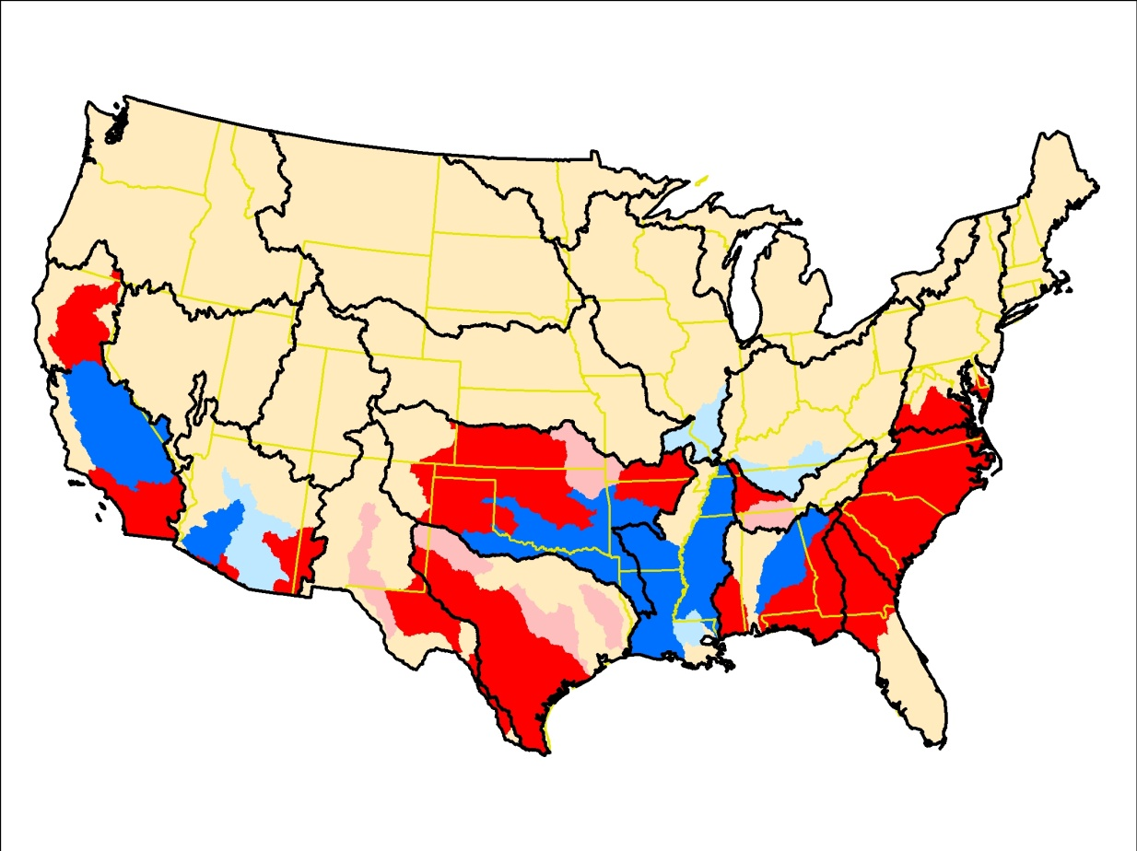
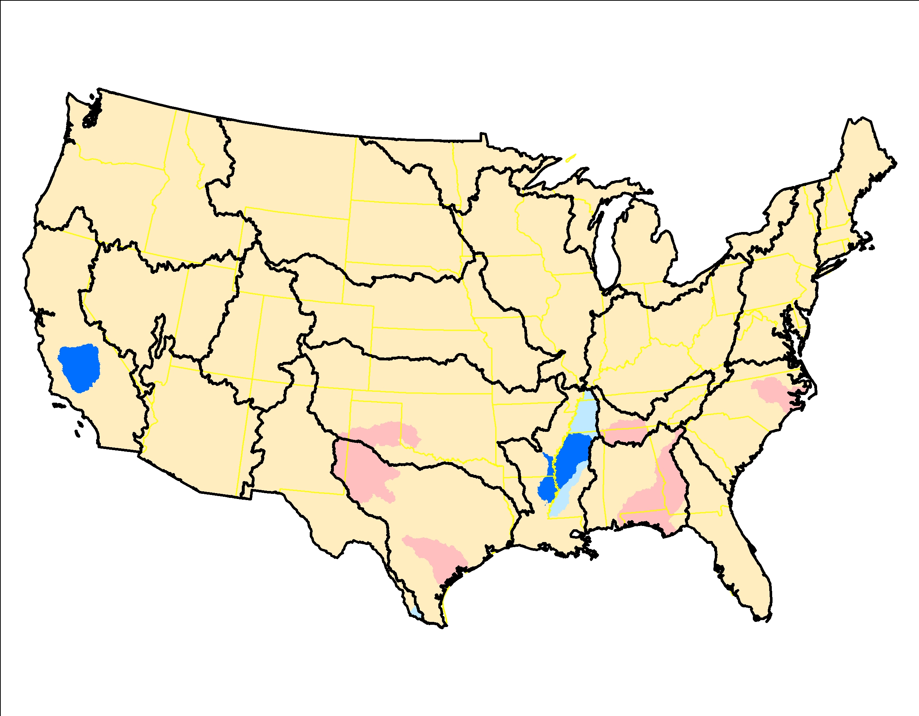
Cotton, 1992-2012, RKT trend significance (left) and slope of trend (right)

Slide 14
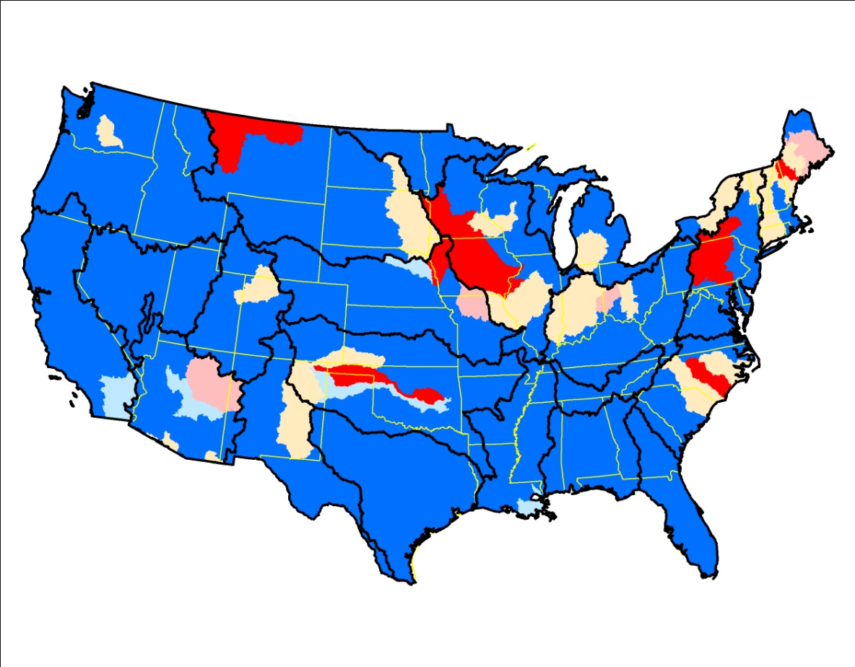
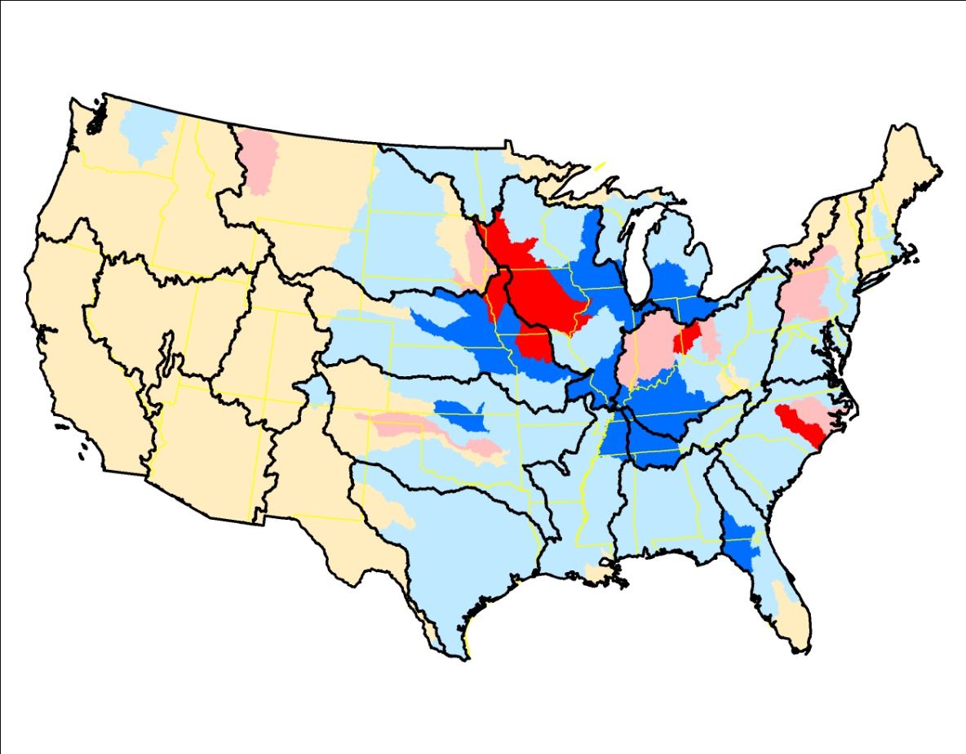
Hogs and pigs, 1992-2012, RKT trend significance (left) and slope of trend (right)

Slide 15
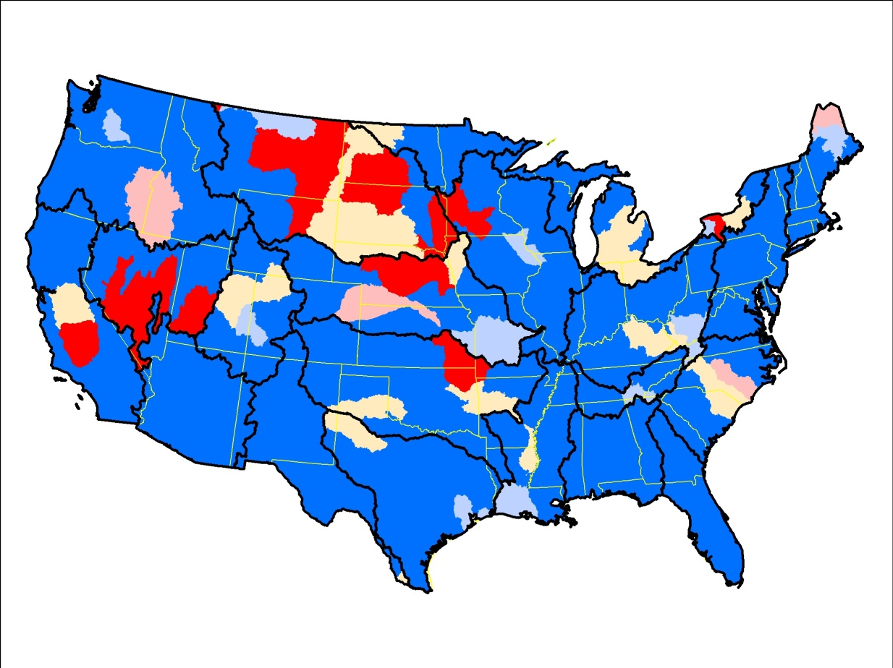
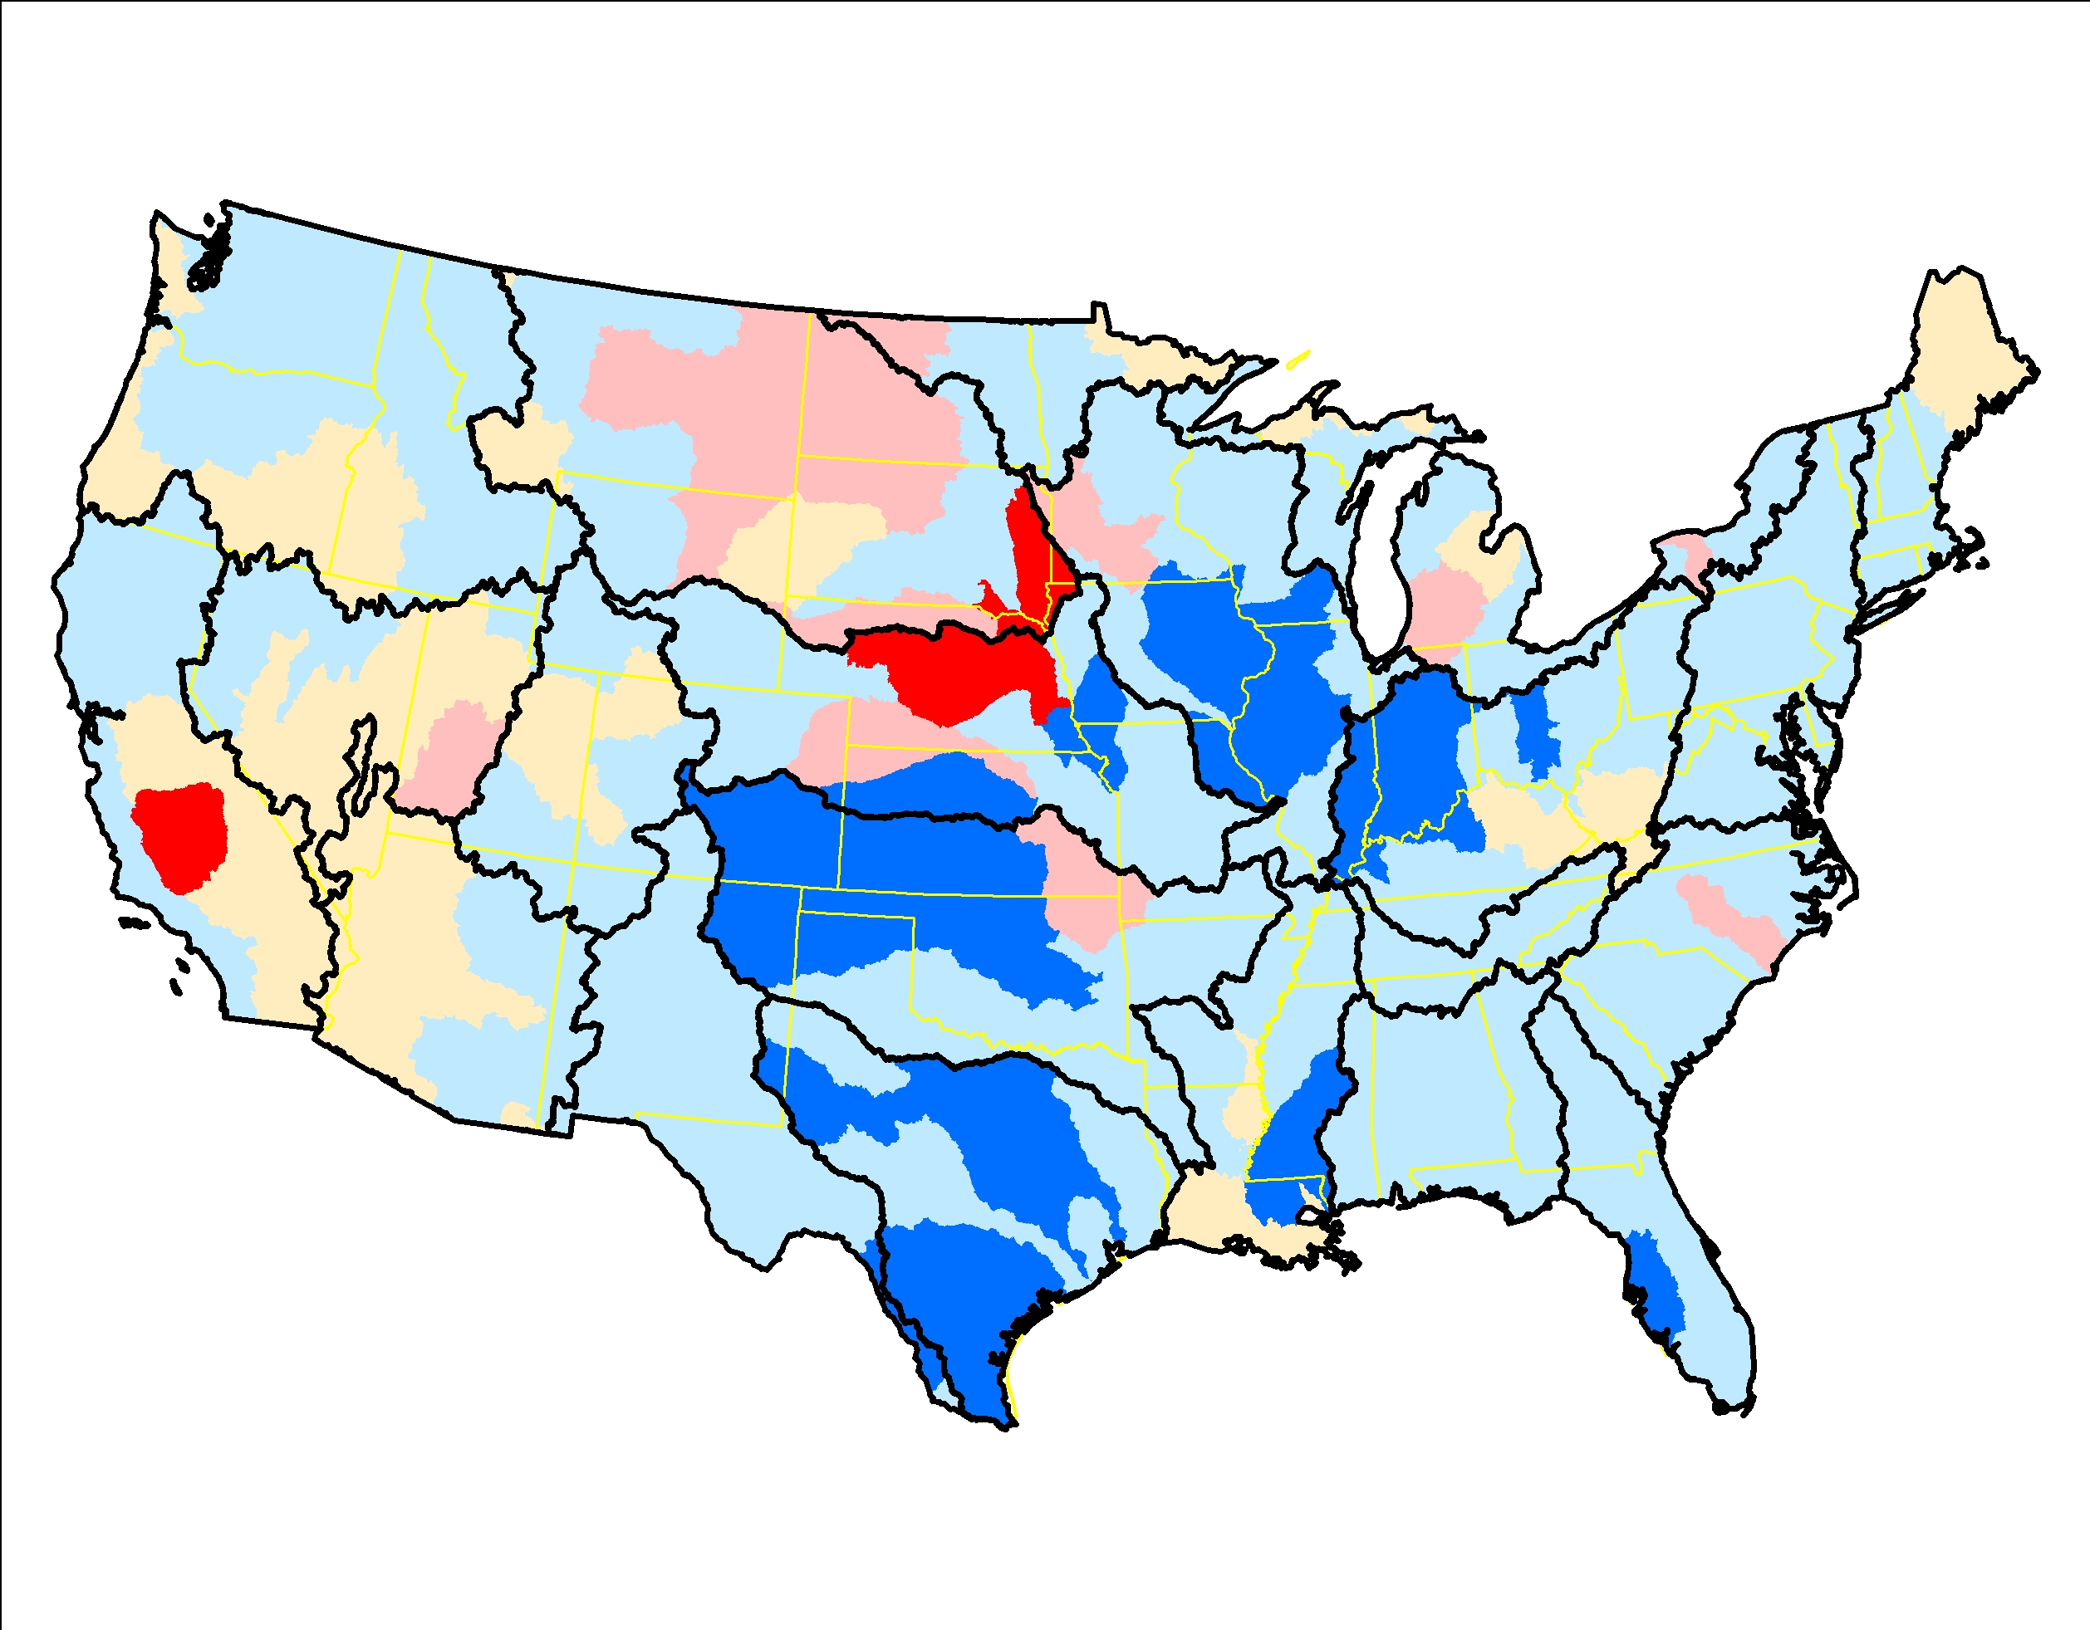
Cows and calves, 1992-2012, RKT trend significance (left) and slope of trend (right)

Slide 16
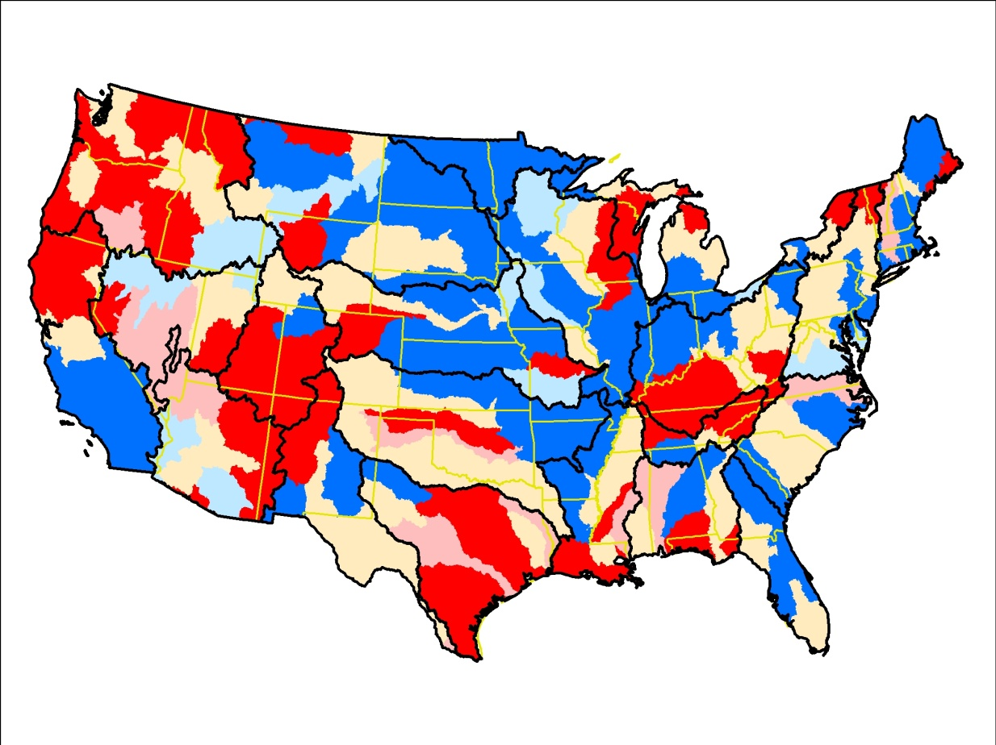
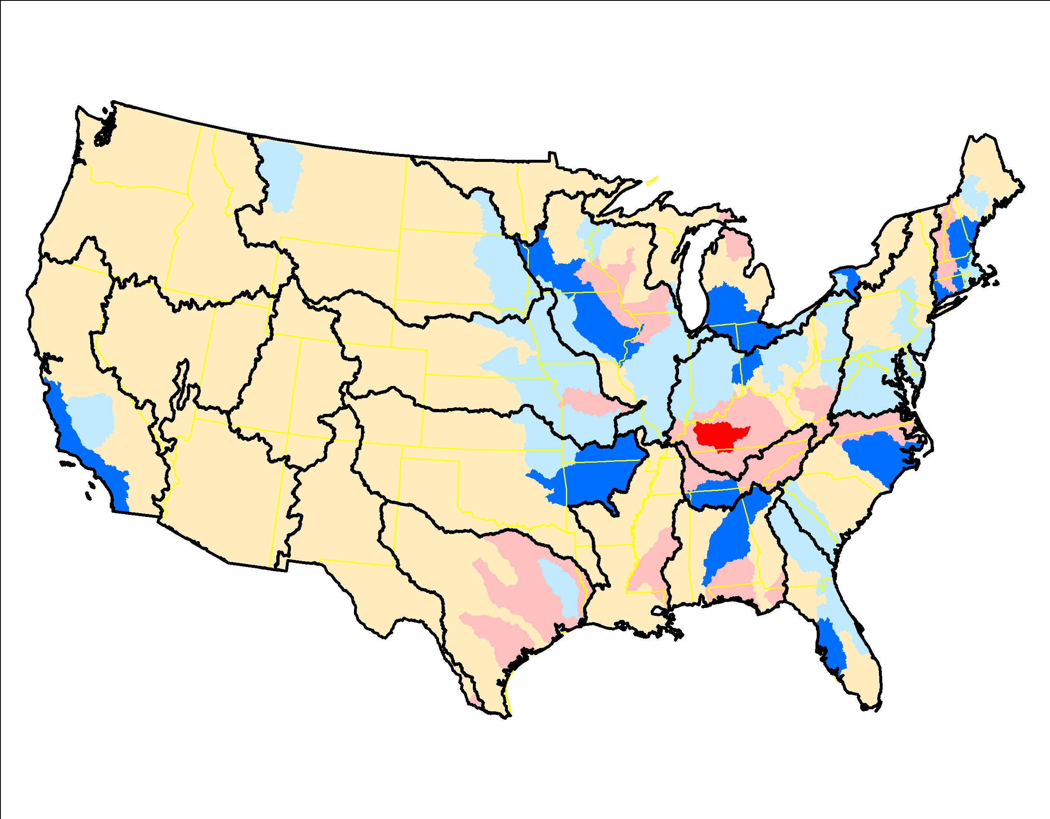
Chickens (layers), 1992-2012, RKT trend significance (left) and slope of trend (right)

Slide 17
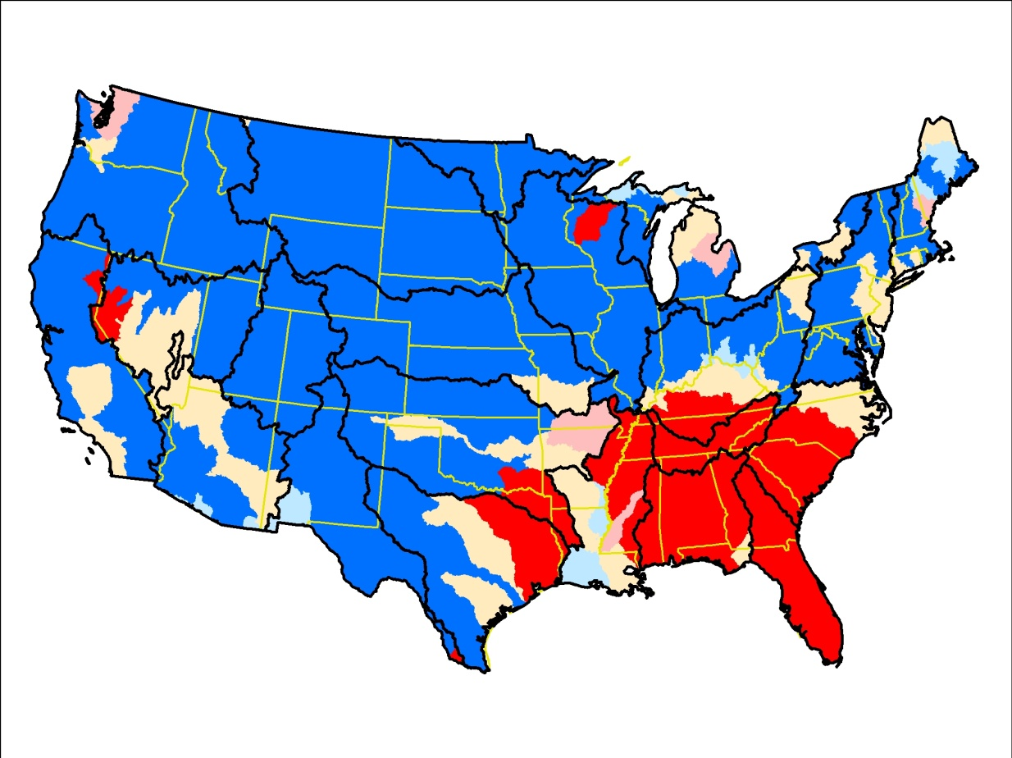
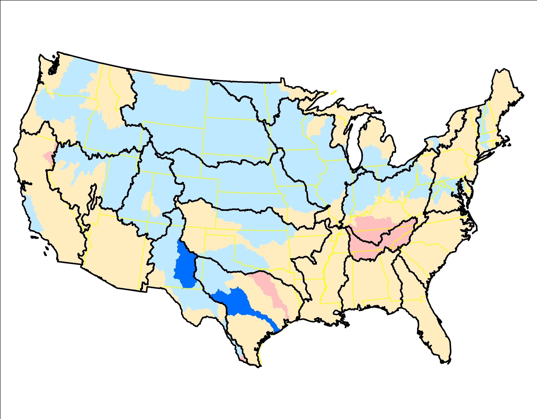
Sheep and lambs, 1992-2012, RKT trend significance (left) and slope of trend (right)

Slide 18
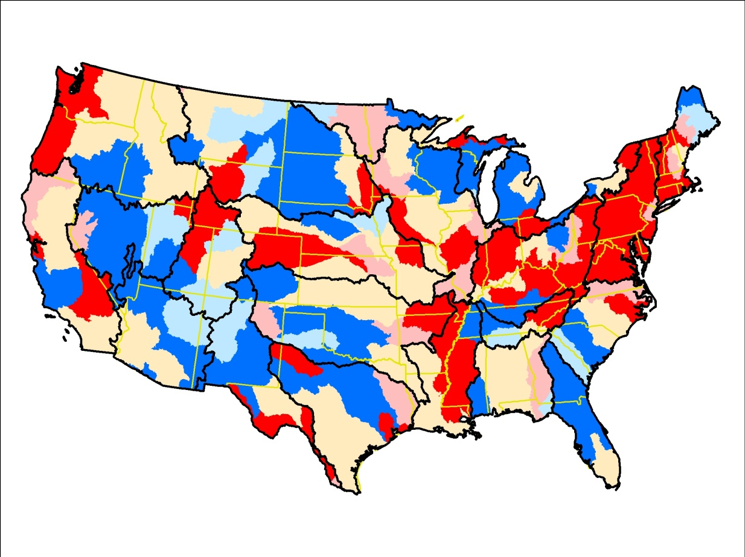
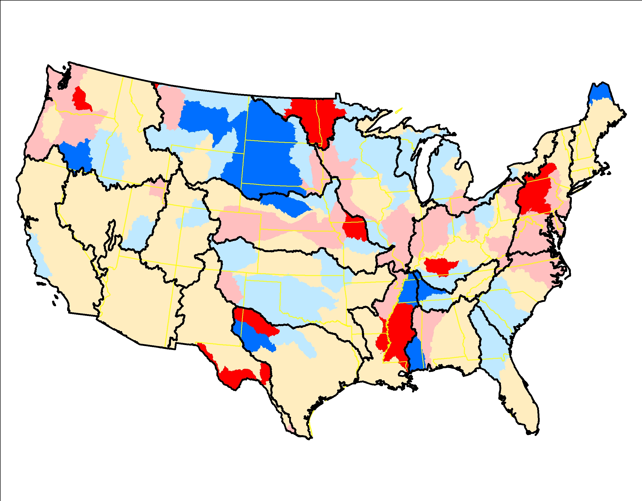
Land in Conservation Reserve Program, 1992-2012, RKT trend significance (left) and slope of trend (right)

Slide 19
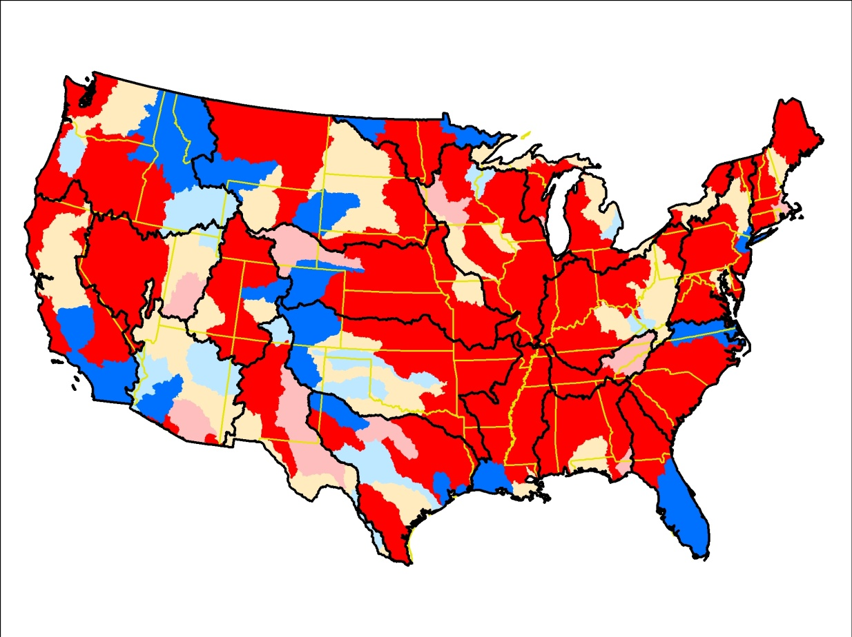
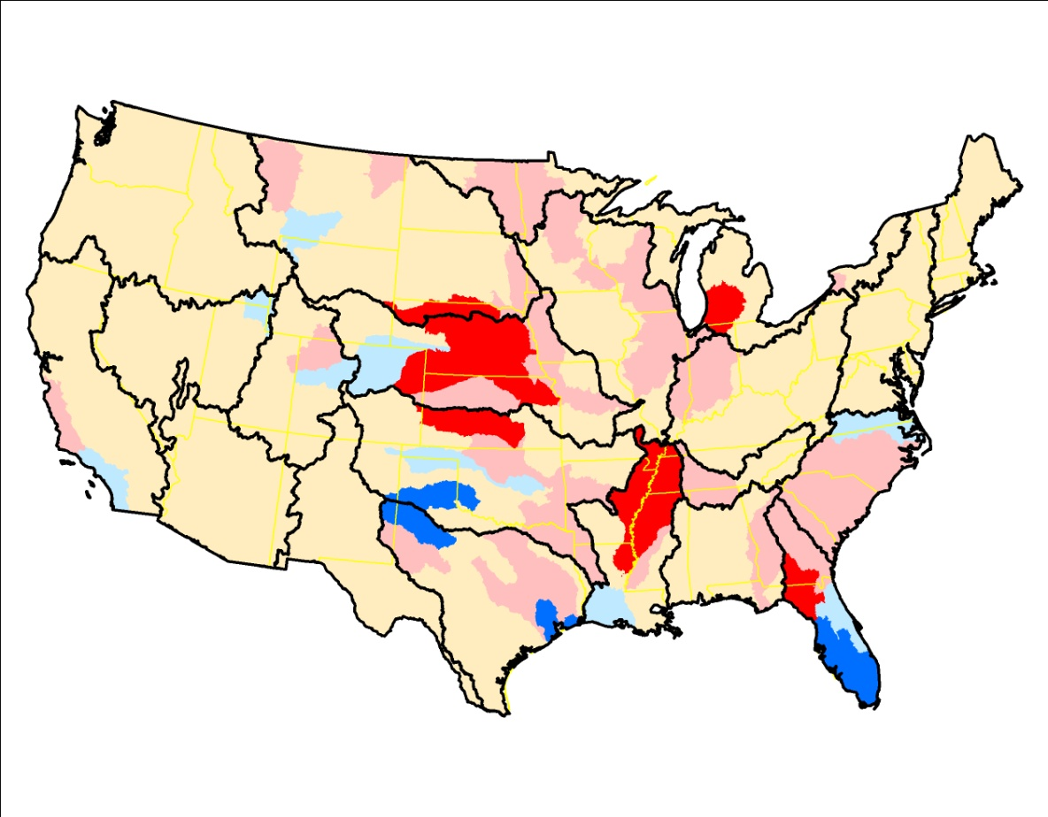
Irrigation (Census of Ag), 1992-2012, RKT trend significance (left) and slope of trend (right)

Slide 20
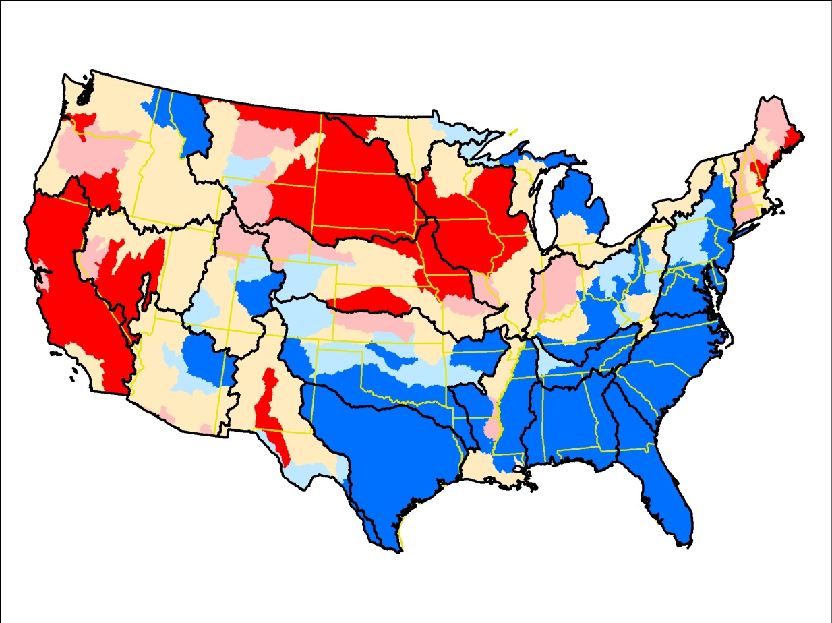
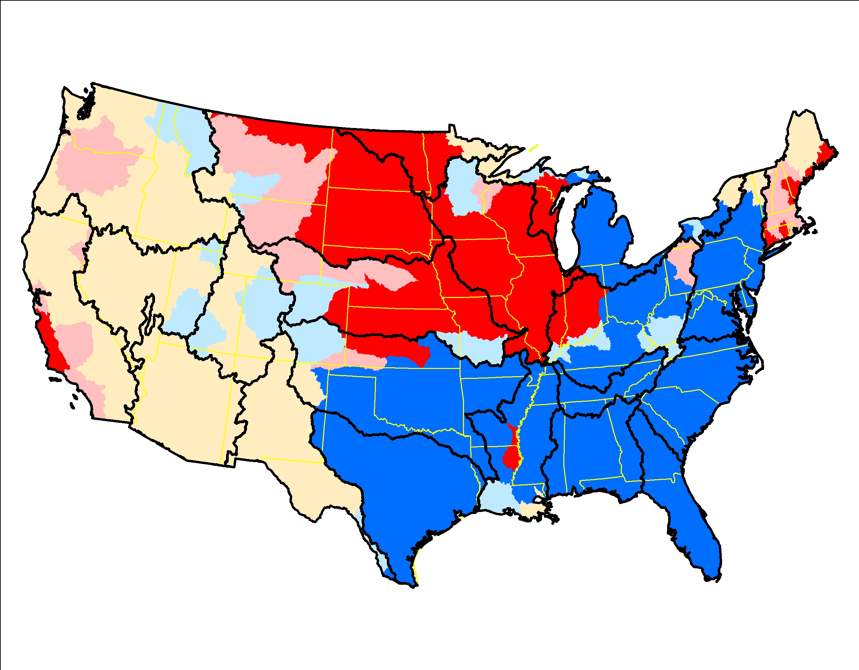
Nitrogen from farm fertilizer, 1992-2012, RKT trend significance (left) and slope of trend (right)

Slide 21
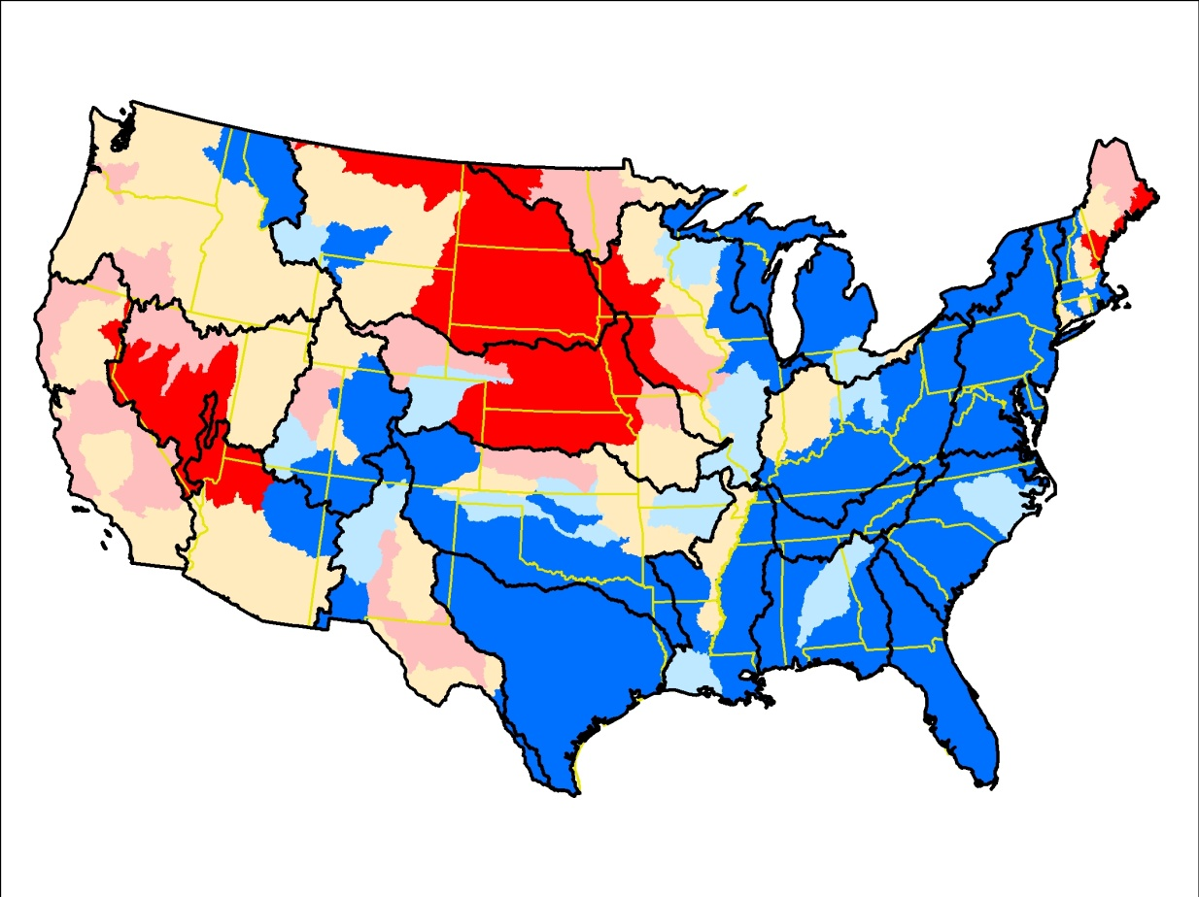
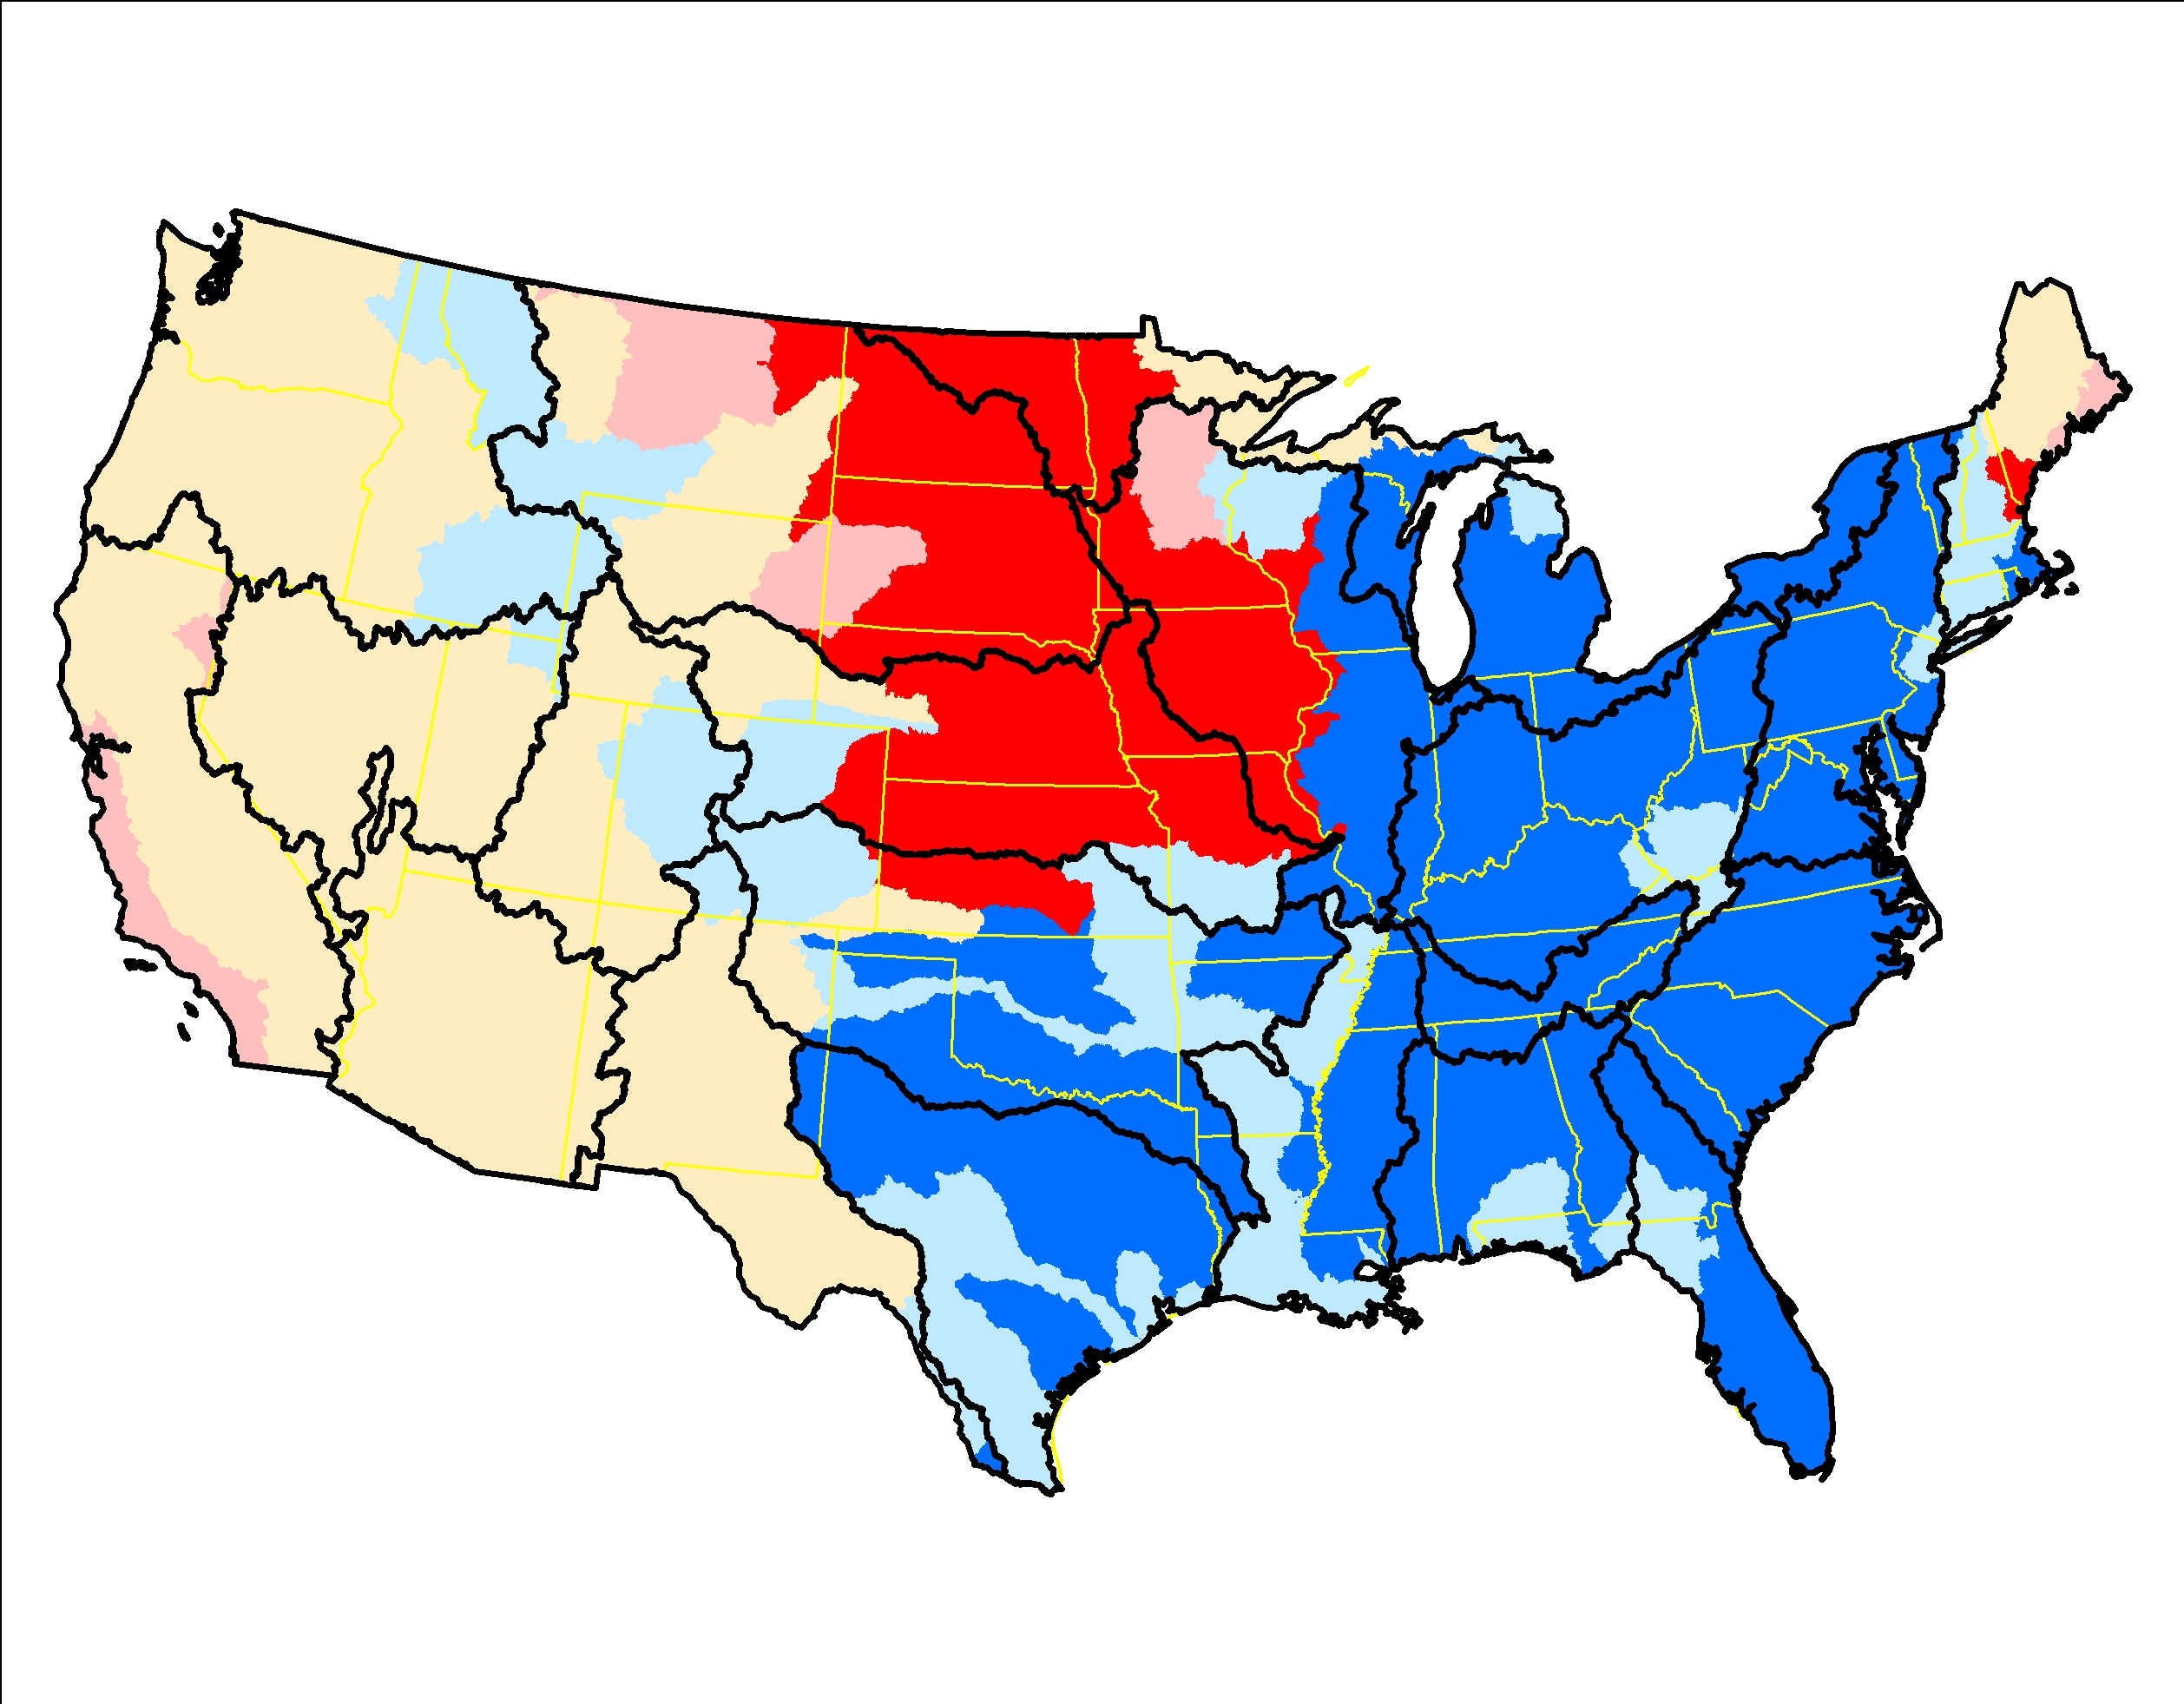
Phosphorus from farm fertilizer, 1992-2012, RKT trend significance (left) and slope of trend (right)

Slide 22
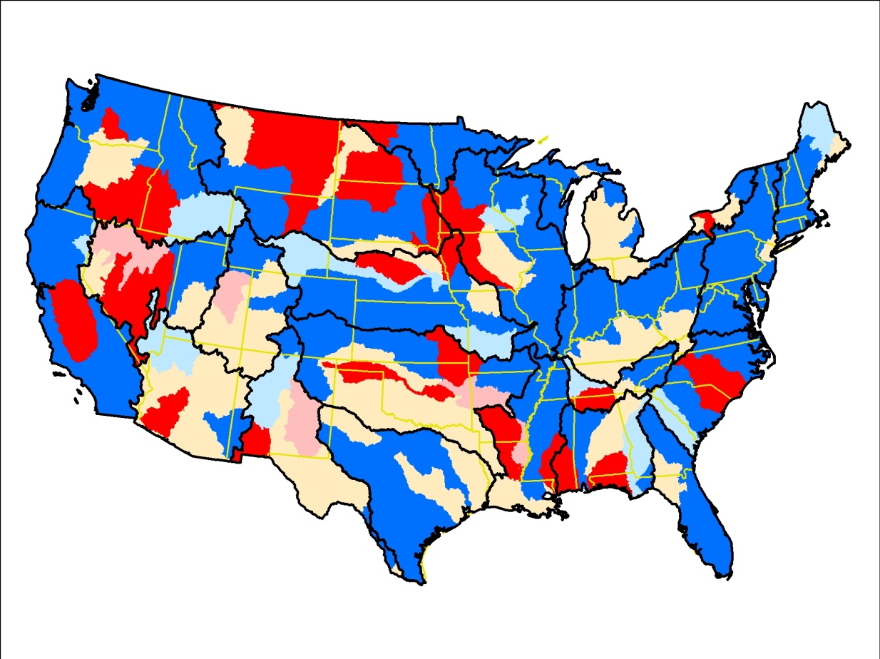
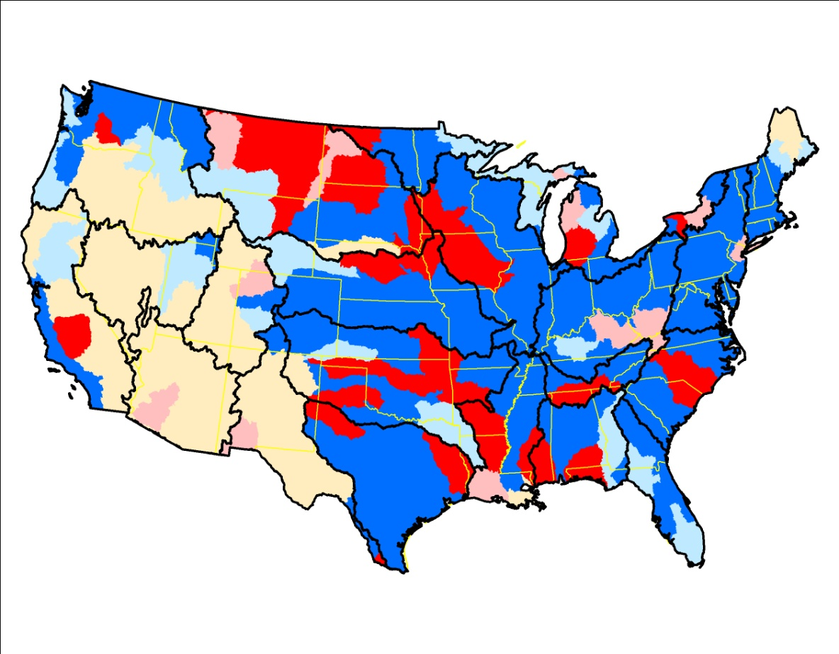
Nitrogen from manure, 1992-2012, RKT trend significance (left) and slope of trend (right)

Slide 23
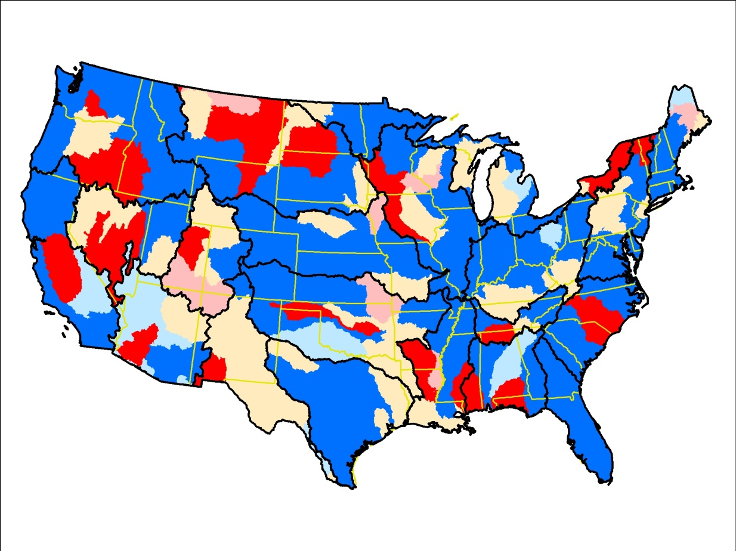
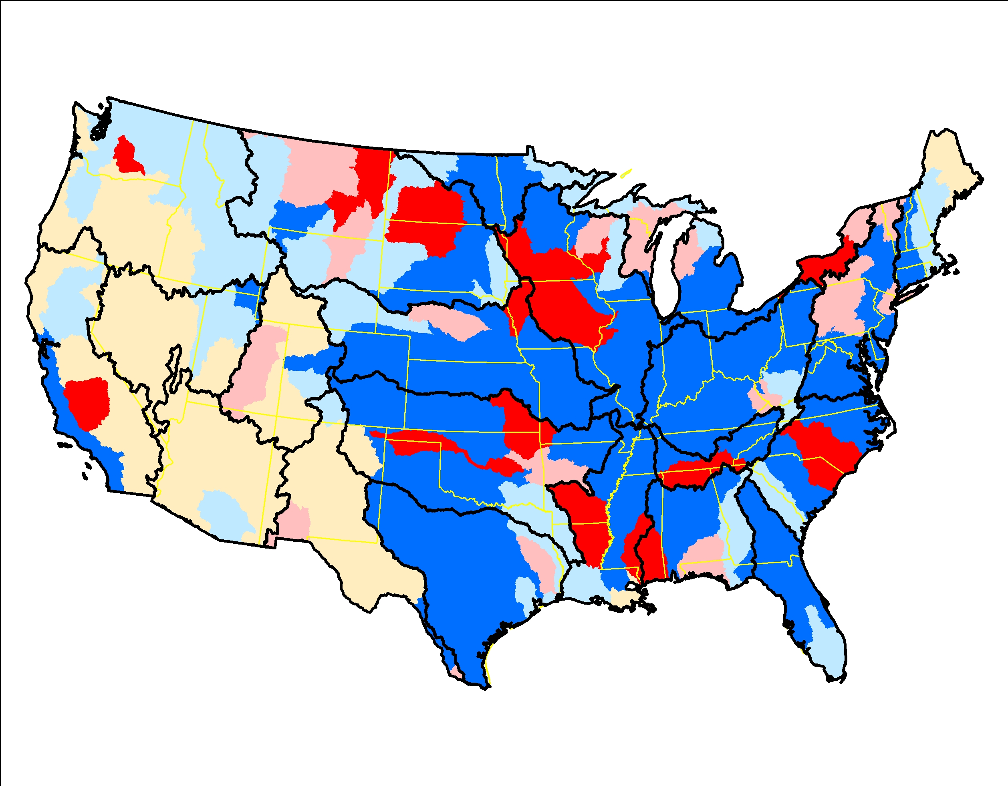
Phosphorus from manure, 1992-2012, RKT trend significance (left) and slope of trend (right)

Slide 24
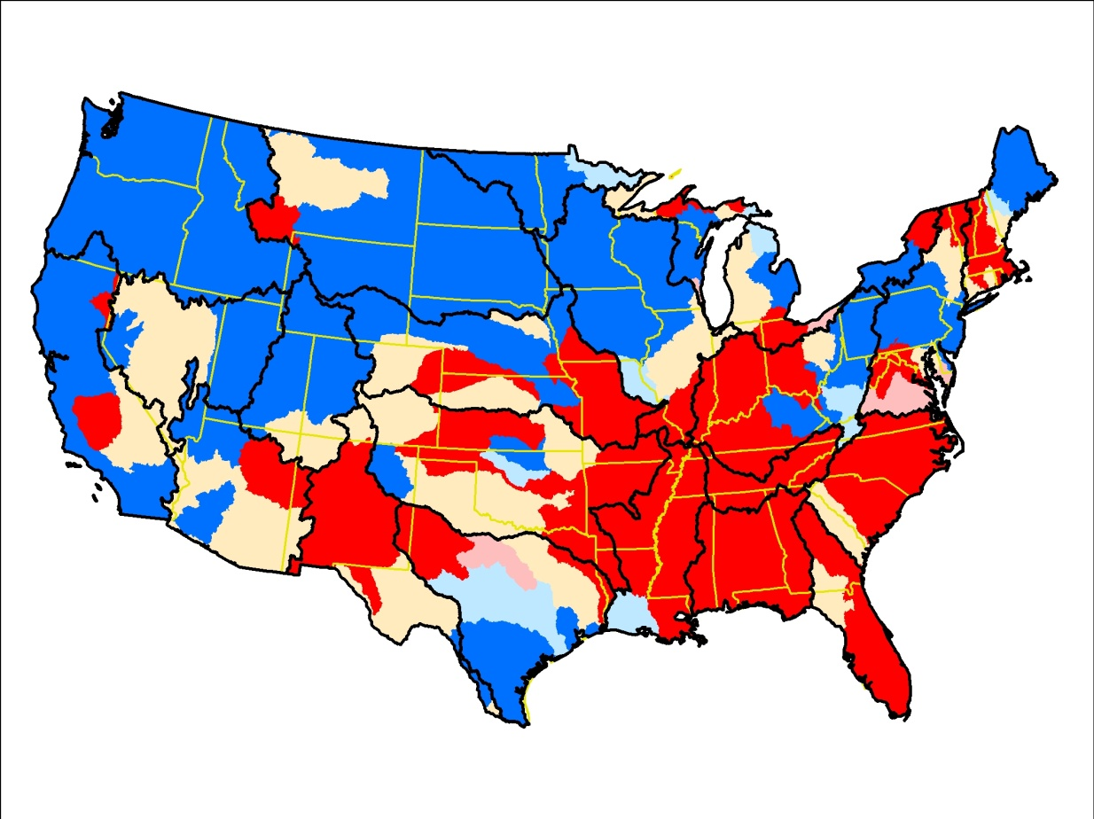
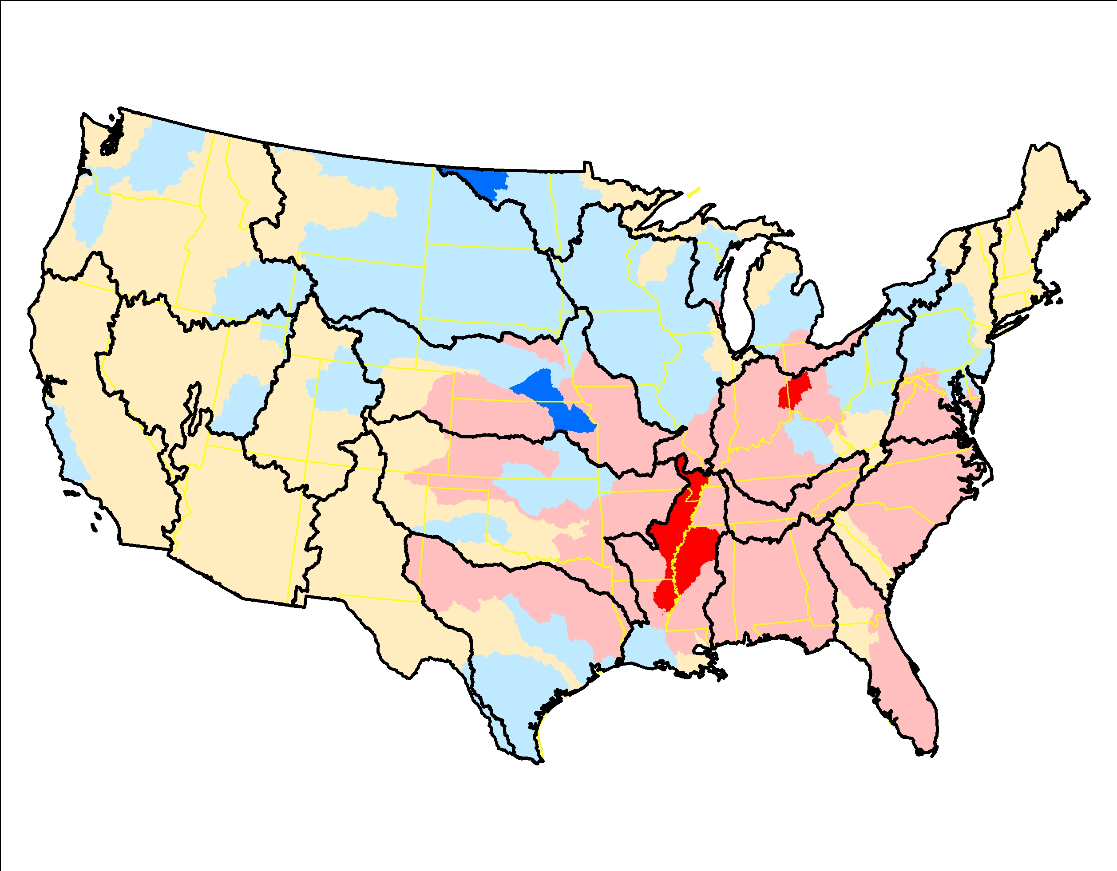
Pesticide – 2,4-D, 1992-2012, RKT trend significance (left) and slope of trend (right)

Slide 25
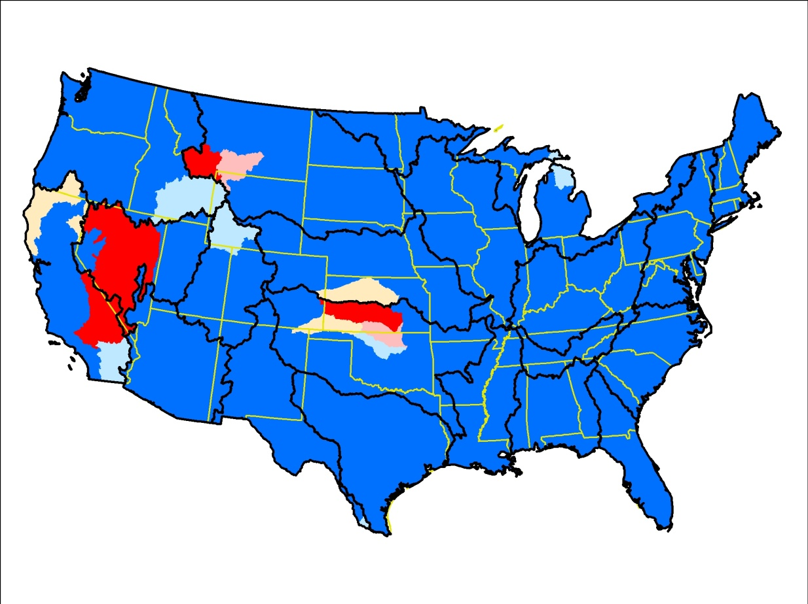
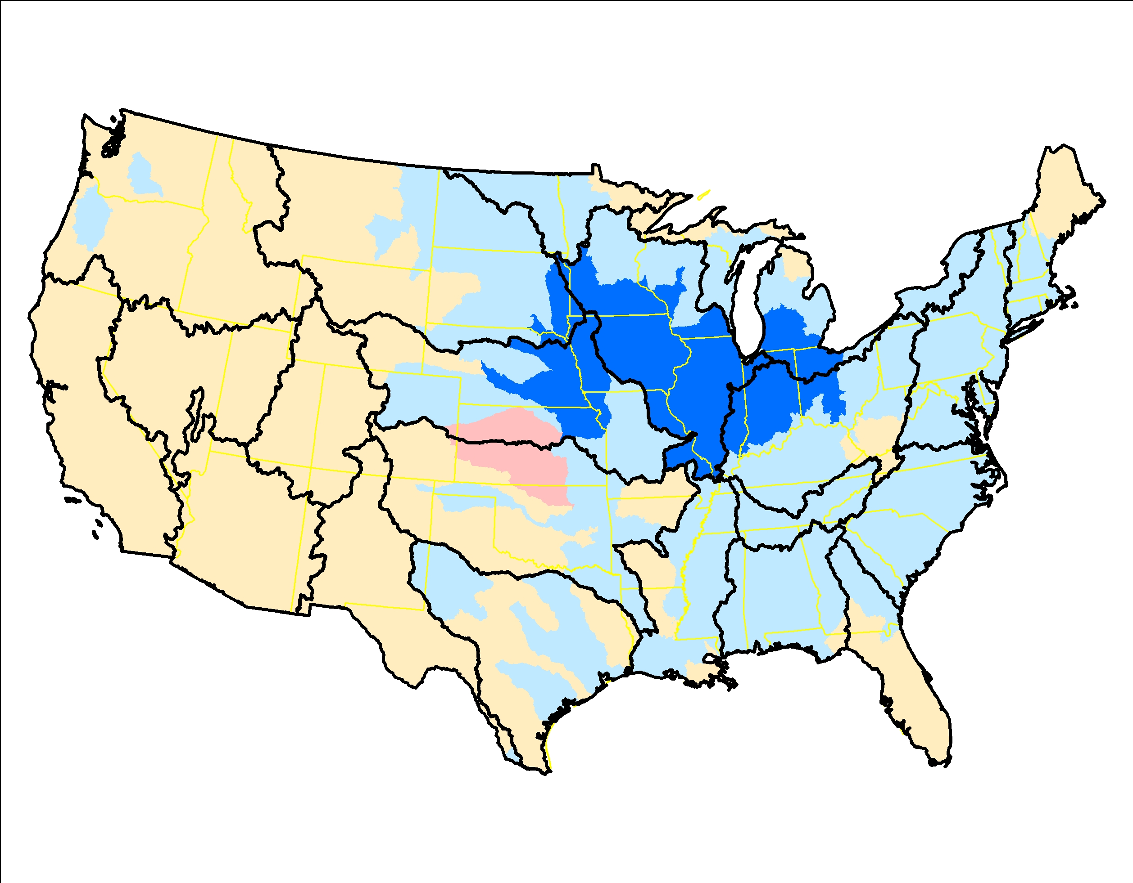
Pesticide – Alachlor, 1992-2012, RKT trend significance (left) and slope of trend (right)

Slide 26
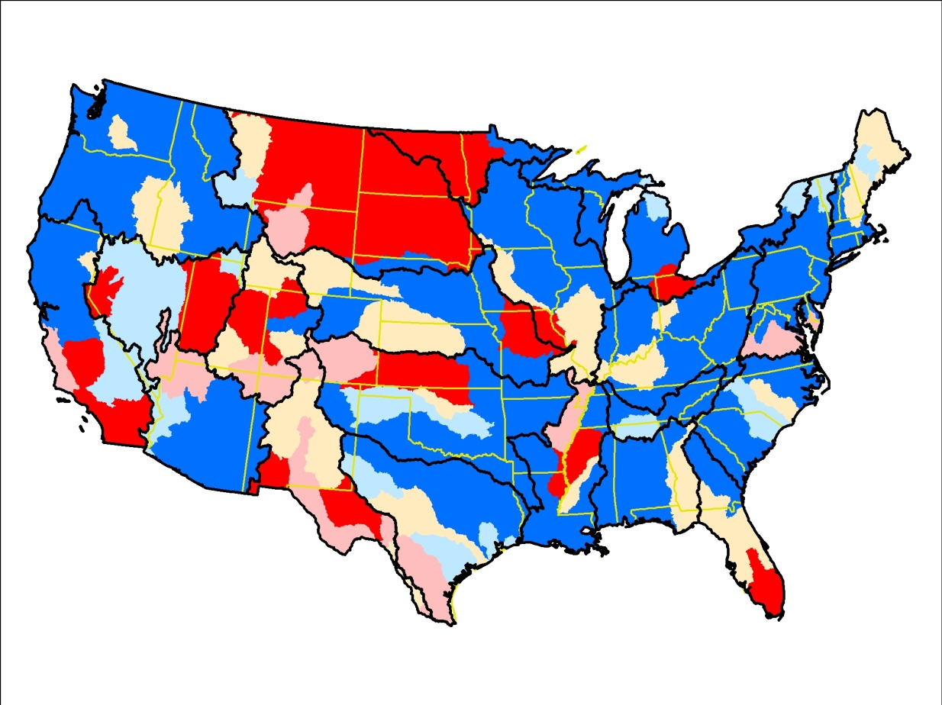
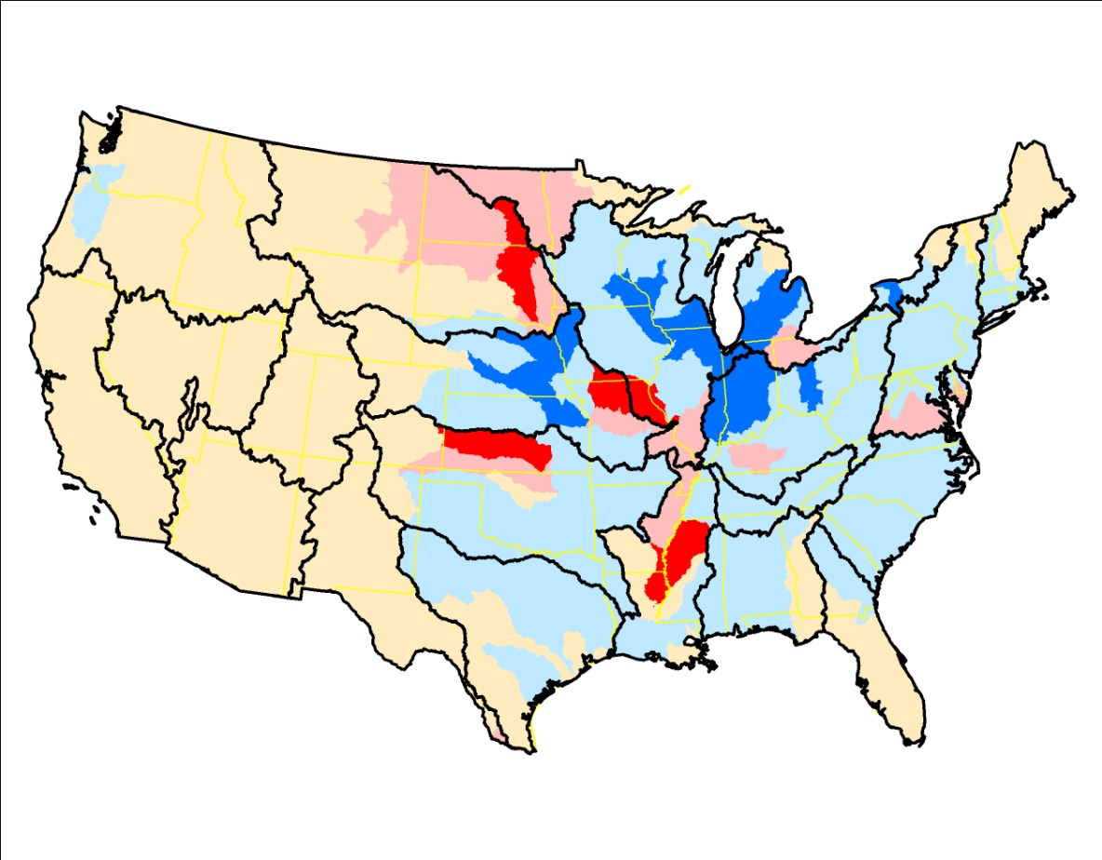
Pesticide – Atrazine, 1992-2012, RKT trend significance (left) and slope of trend (right)

Slide 27


Pesticide – Carbaryl, 1992-2012, RKT trend significance (left) and slope of trend (right)

Slide 28


Pesticide – Chlorpyrifos, 1992-2012, RKT trend significance (left) and slope of trend (right)

Slide 29


Pesticide – Diazinon, 1992-2012, RKT trend significance (left) and slope of trend (right)

Slide 30


Pesticide – Dicamba, 1992-2012, RKT trend significance (left) and slope of trend (right)

Slide 31


Pesticide – Glyphosate, 1992-2012, RKT trend significance (left) and slope of trend (right)

Slide 32


Pesticide – Malathion, 1992-2012, RKT trend significance (left) and slope of trend (right)

Slide 33


Pesticide – Metolachlor, 1992-2012, RKT trend significance (left) and slope of trend (right)

Slide 34


Pesticide – Simazine, 1992-2012, RKT trend significance (left) and slope of trend (right)

Slide 35


Pesticide – Tebuthiuron, 1992-2012, RKT trend significance (left) and slope of trend (right)

Slide 36


Road salt, 1992-2012, RKT trend significance (left) and slope of trend (right)

Slide 37


Water use, freshwater withdrawals, 1992-2012, RKT trend significance (left) and slope of trend (right)

Slide 38


WWTP total nitrogen yield, 1992-2012, RKT trend significance (left) and slope of trend (right)

Slide 39


WWTP total phosphorus yield, 1992-2012, RKT trend significance (left) and slope of trend (right)

